Slide 1


The use of the Digital Commons Data repository of Babes-Bolyai University, Cluj-Napoca
(DCD-UBB)
- Guide for users who are members of the UBB community -
v. 0.1, April 2024

Slide 2
Table of contents
Overview
Registering a New Dataset
Registering a New Collection of Datasets
Registering a New Collaborative Project
Usage Policies of the DCD-UBB Data Repository

Slide 3
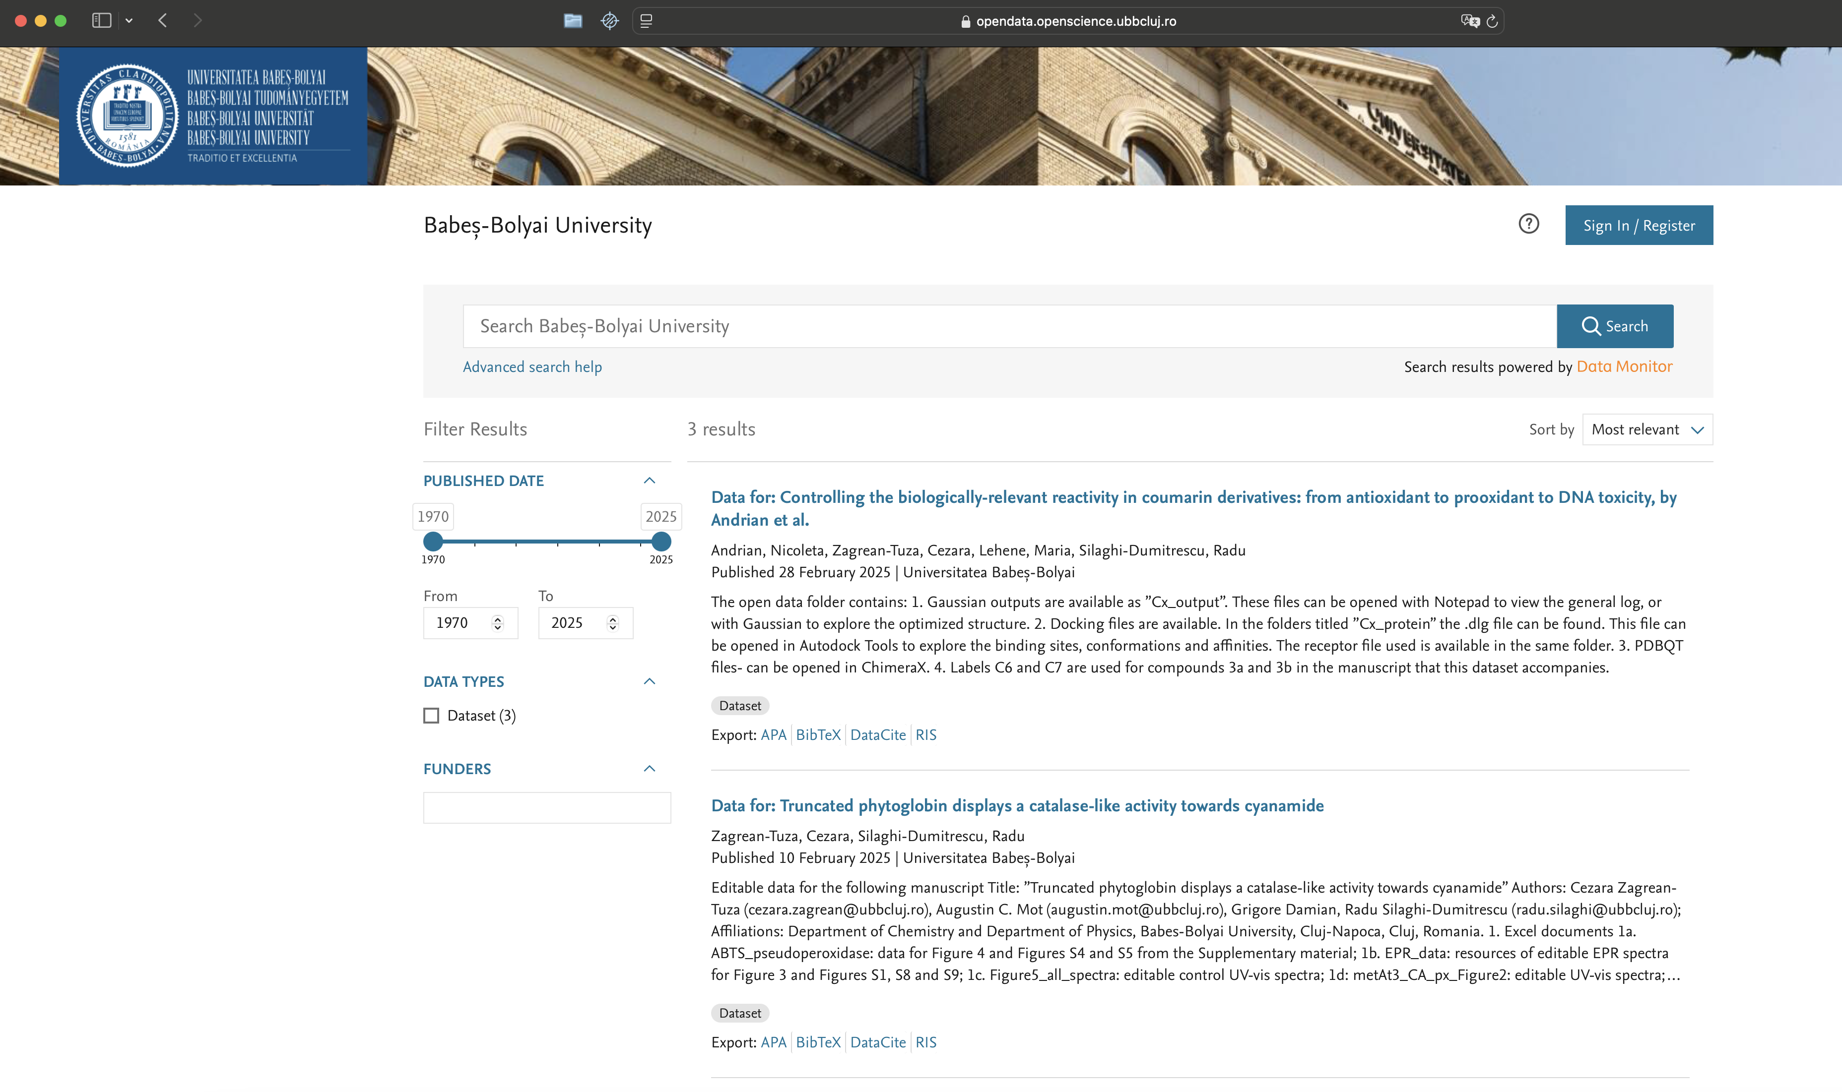
Overview

Slide 4
Access https://opendata.openscience.ubbcluj.ro
Click on Sign In / Register

Slide 5
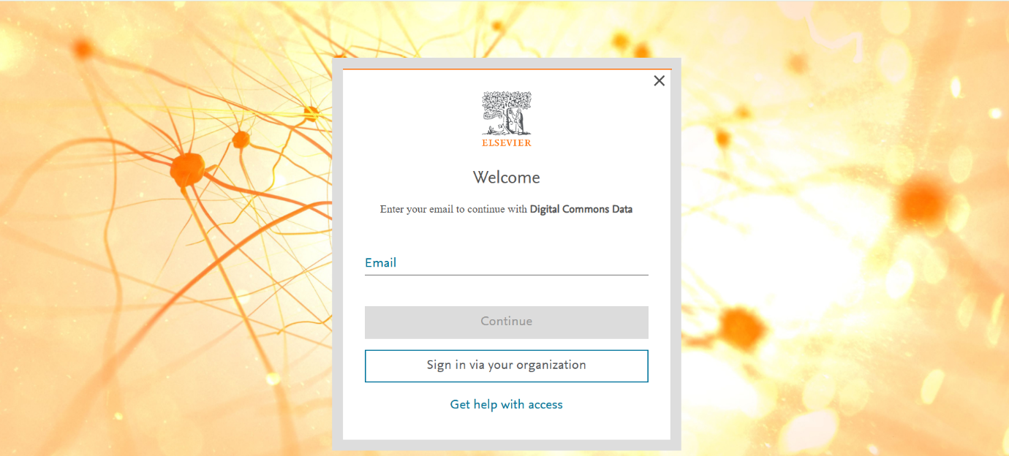
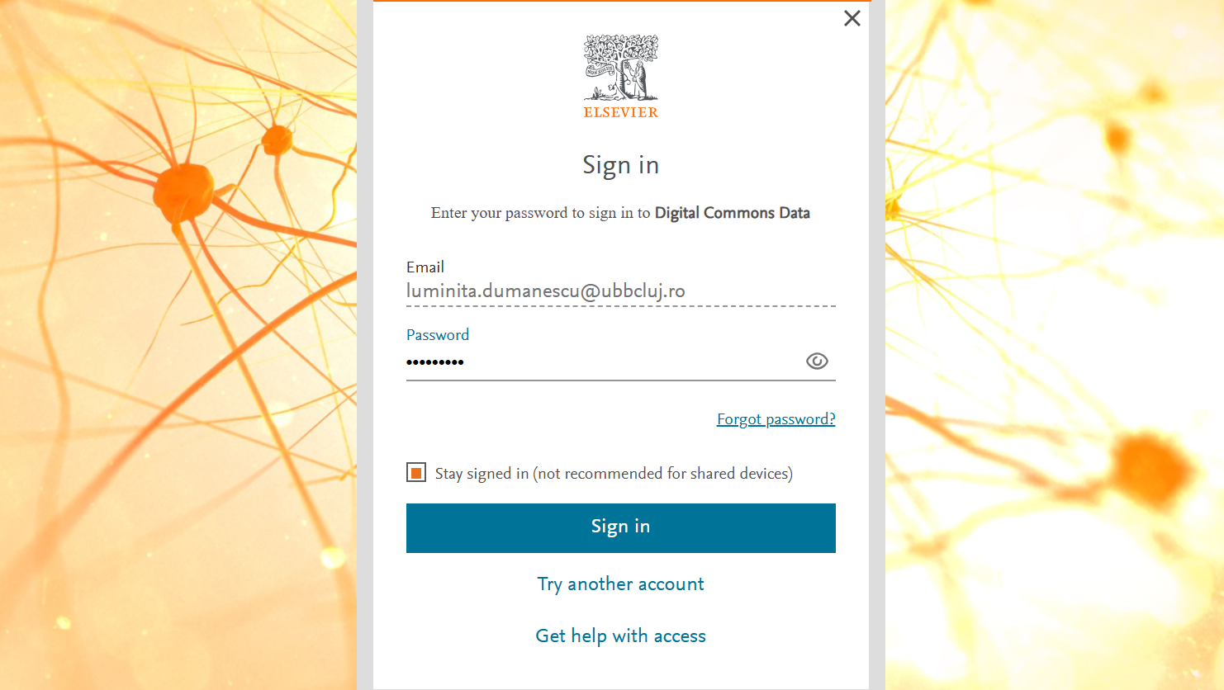
Select the registration
via email
Do not attempt automatic access using the institutional account
Enter your UBB institutional email address
and set up a new
password

Slide 6
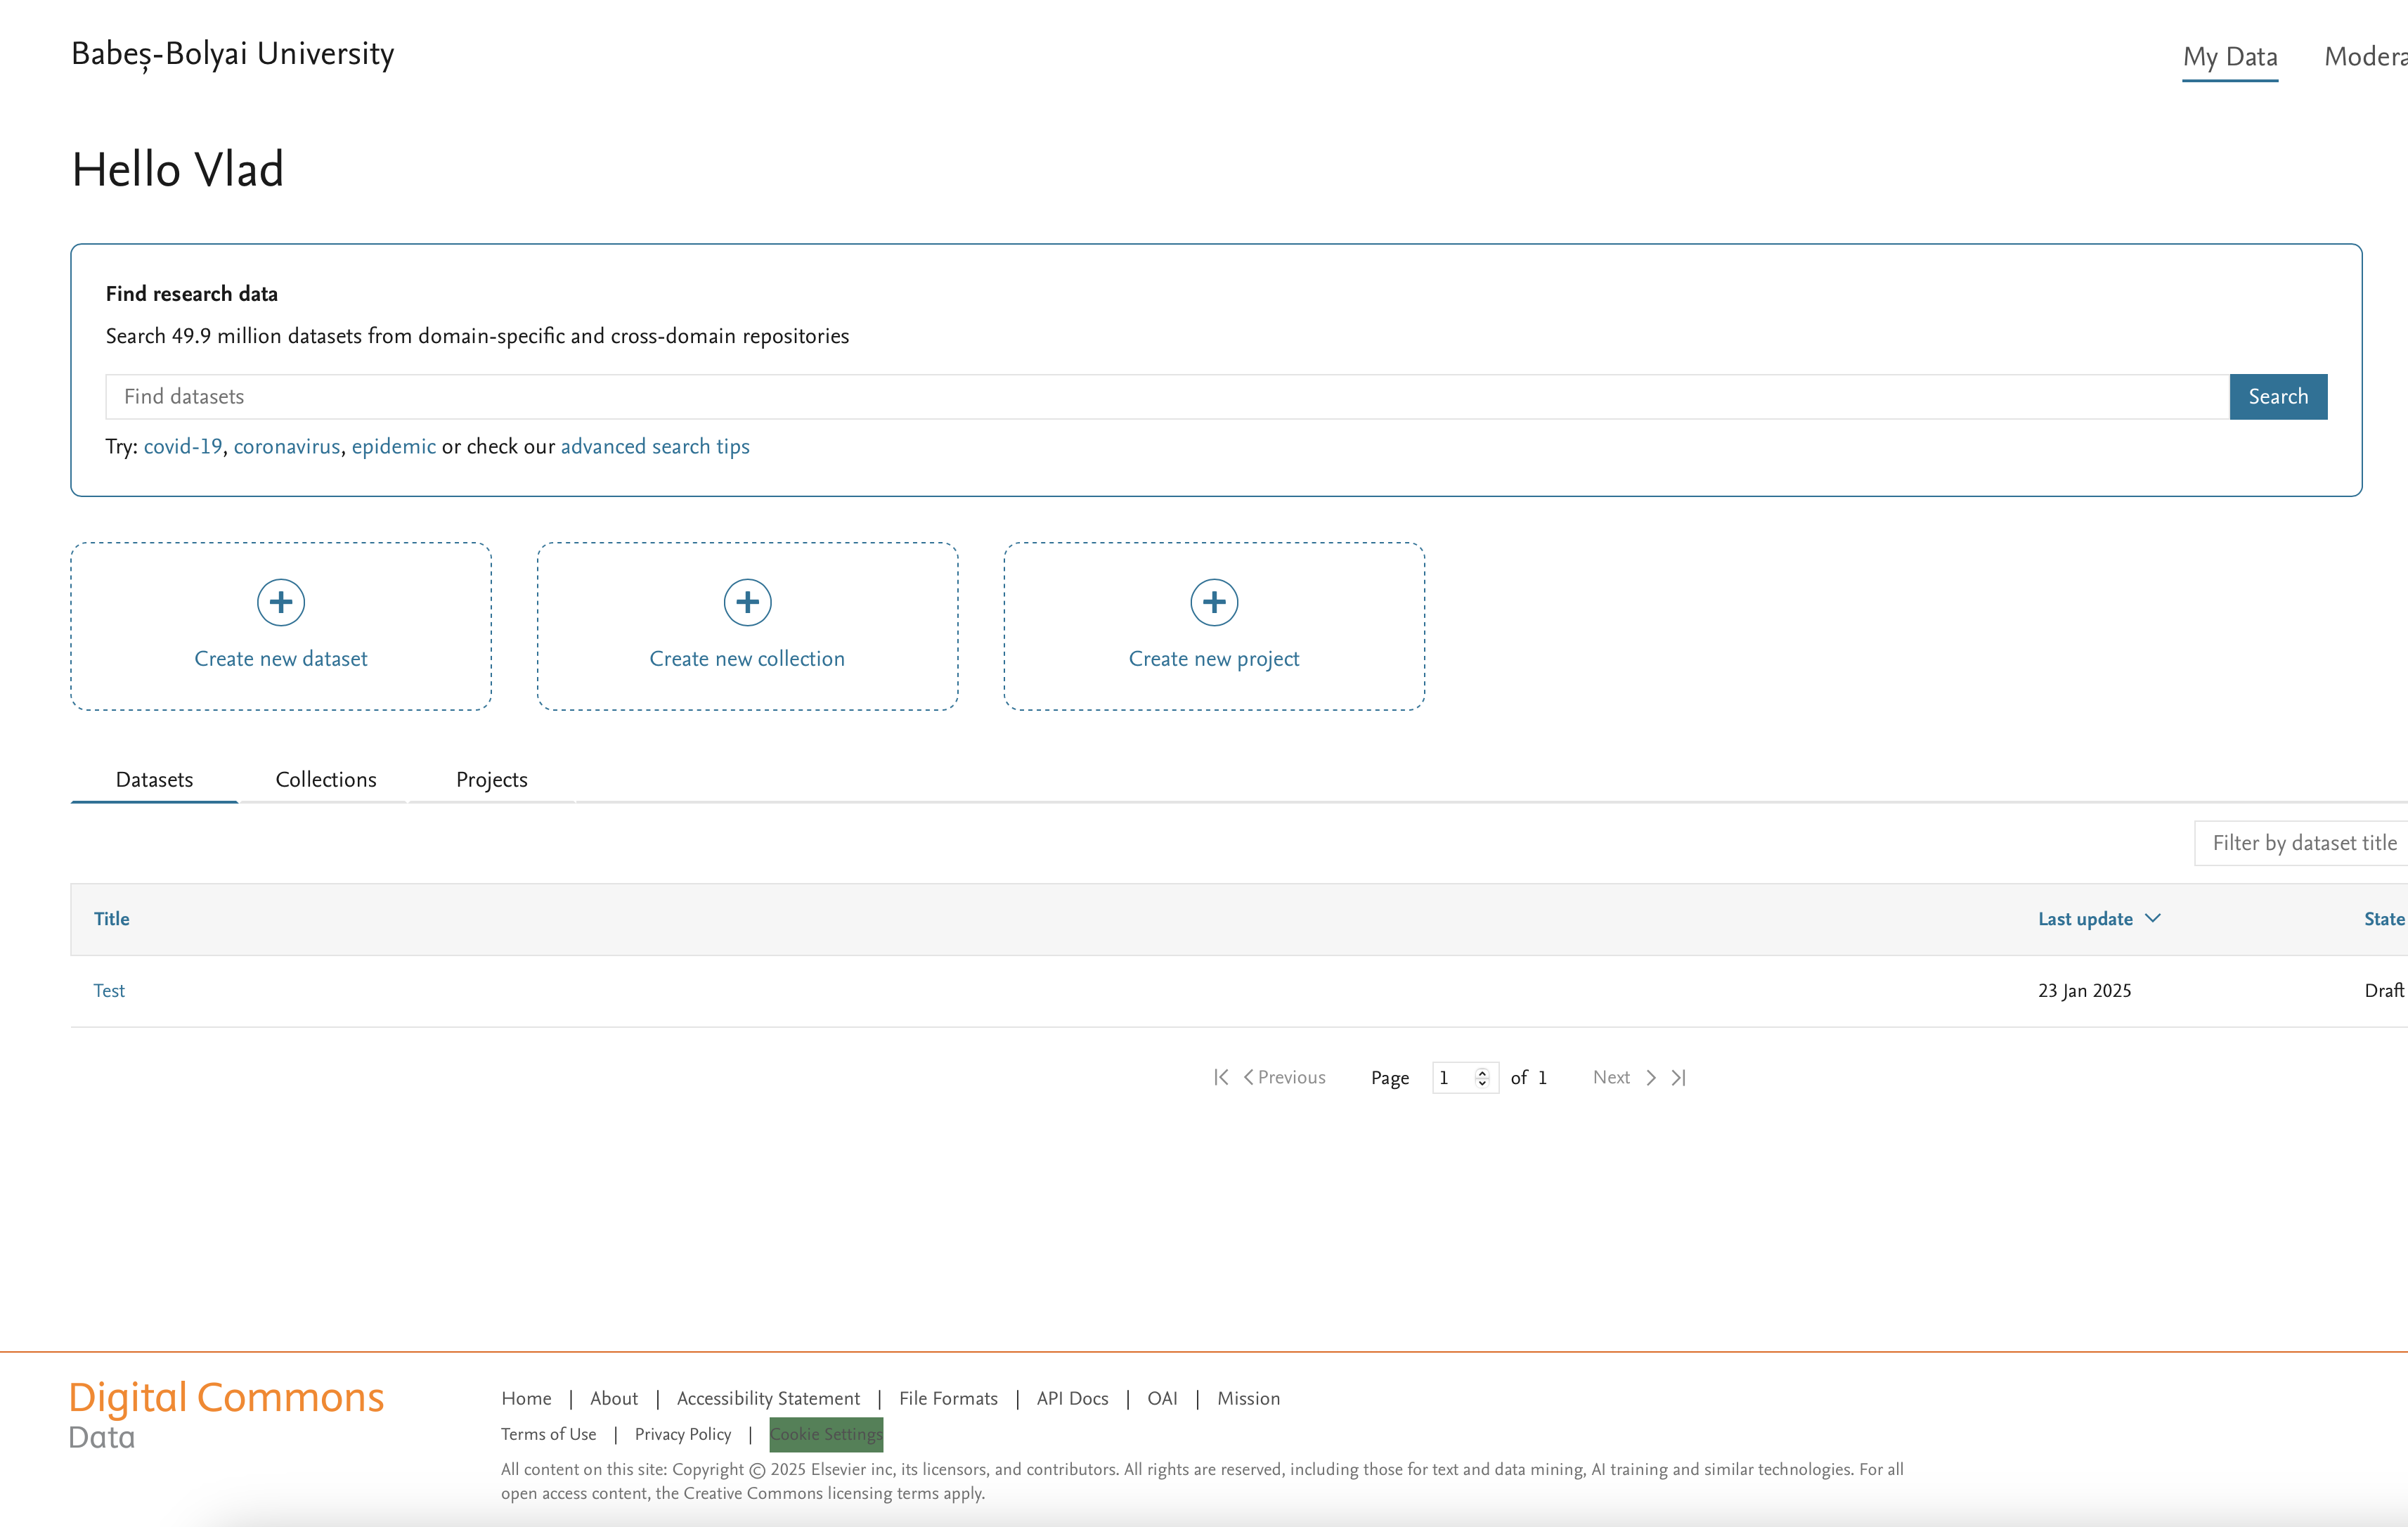
After registration, you will be redirected to the My Data section

Slide 7
Once here, check if Babeș-Bolyai University is displayed in the upper left corner of the page.
If the university’s name appears, you may proceed.
If Mendeley Data is displayed, please contact us at the
email address: vlad.popovici@ubbcluj.ro

Slide 8
To search exclusively within DCD-UBB,
access the link on the University’s name.
The My Data section also includes access
to a search engine in Mendeley Data.

Slide 9
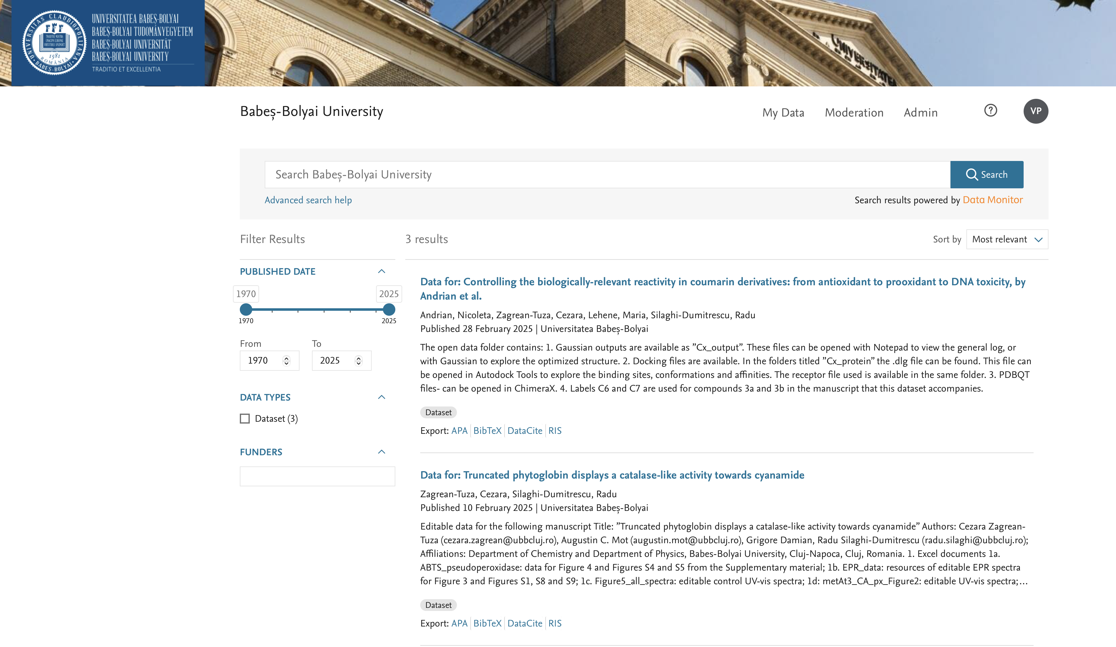
The search engine for DCD-UBB is located on the repository’s main page
and includes filters and keyword search.

Slide 10
The procedures for uploading datasets, creating collections, and projects are accessible in the My Data section.

Slide 11
Here, you can also access and edit your own datasets, collections, and projects.

Slide 12
2. Register a New Dataset

Slide 13
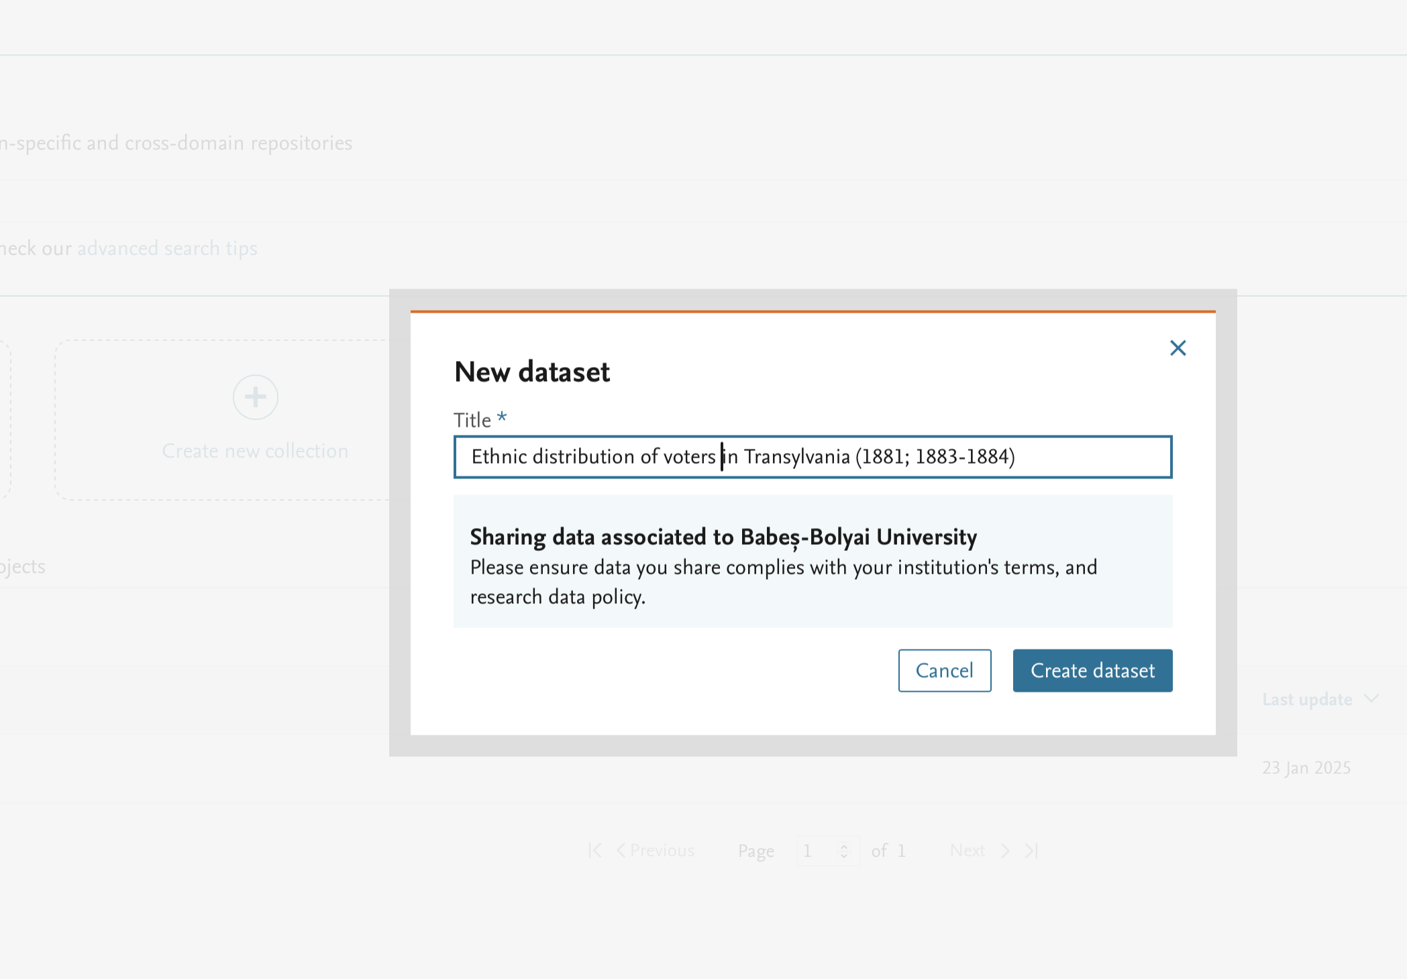
Enter the title of the new dataset.

Slide 14
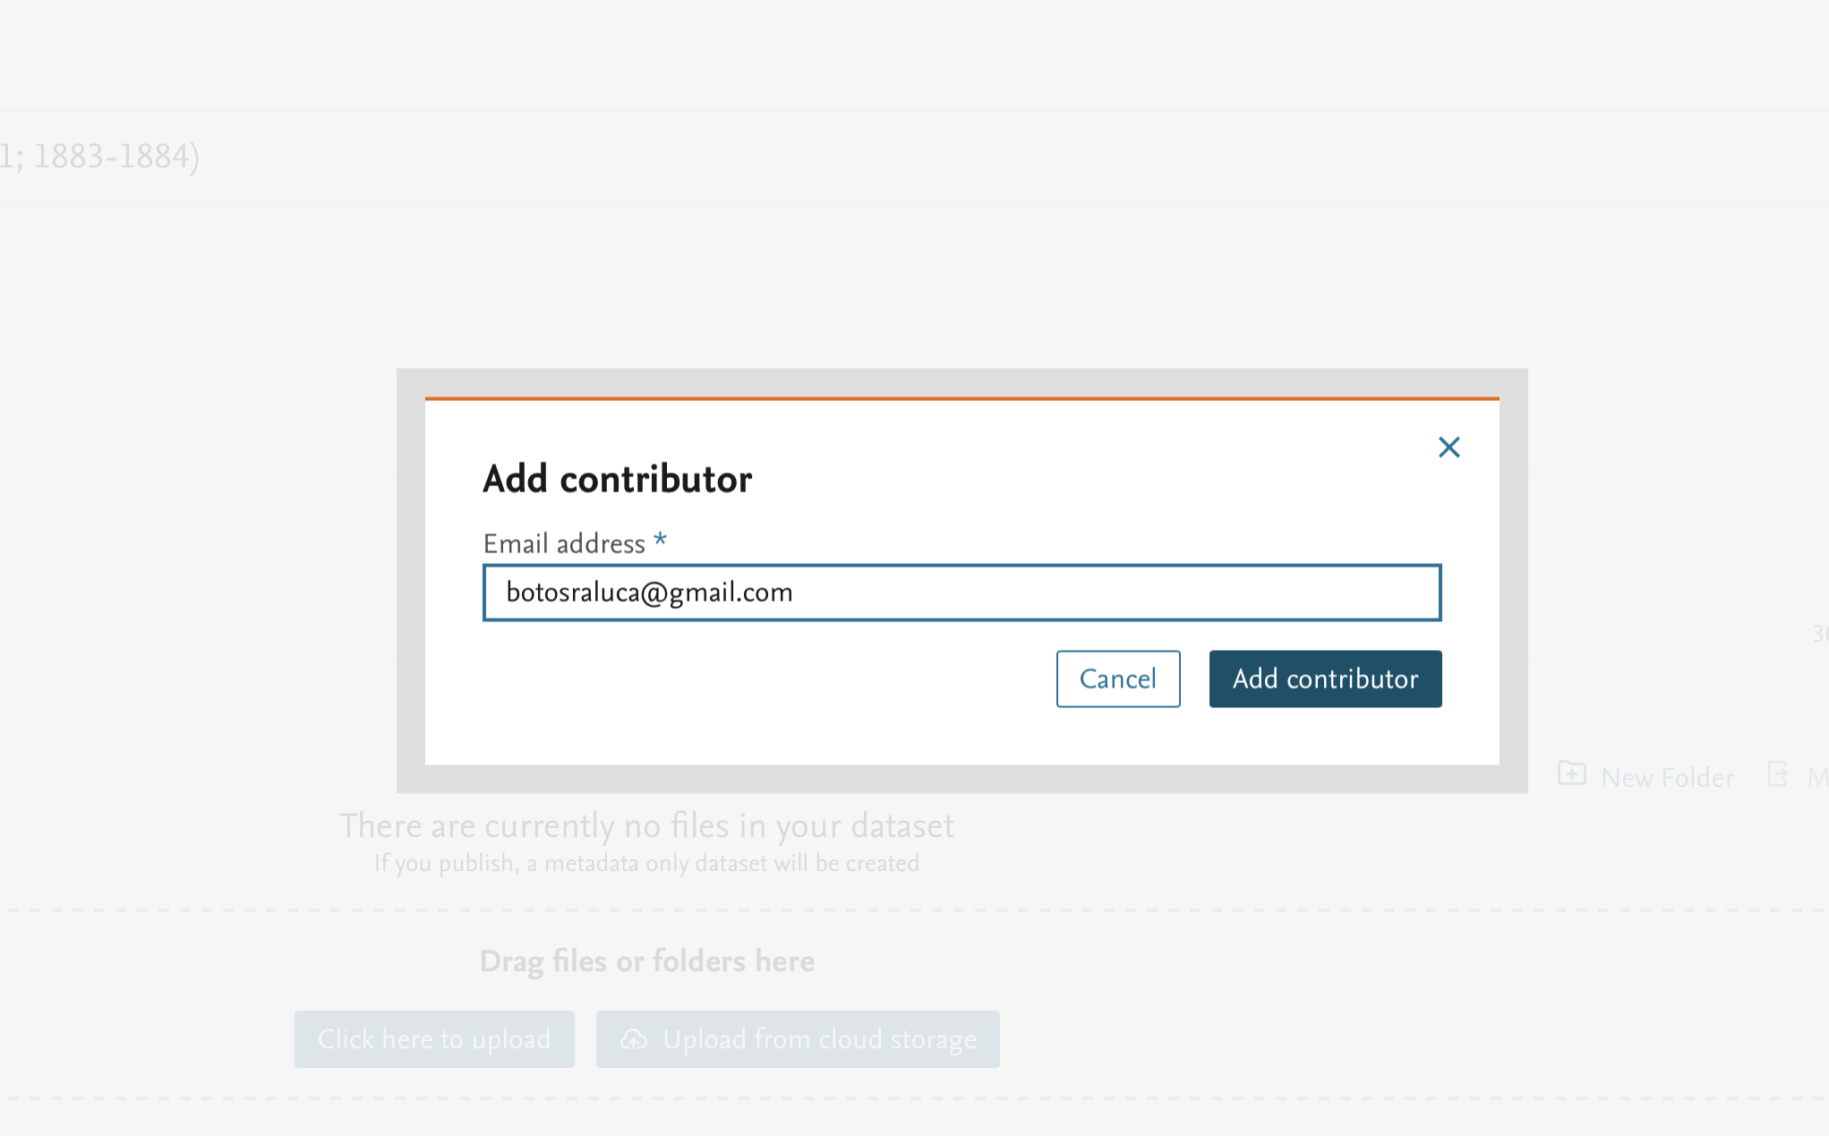
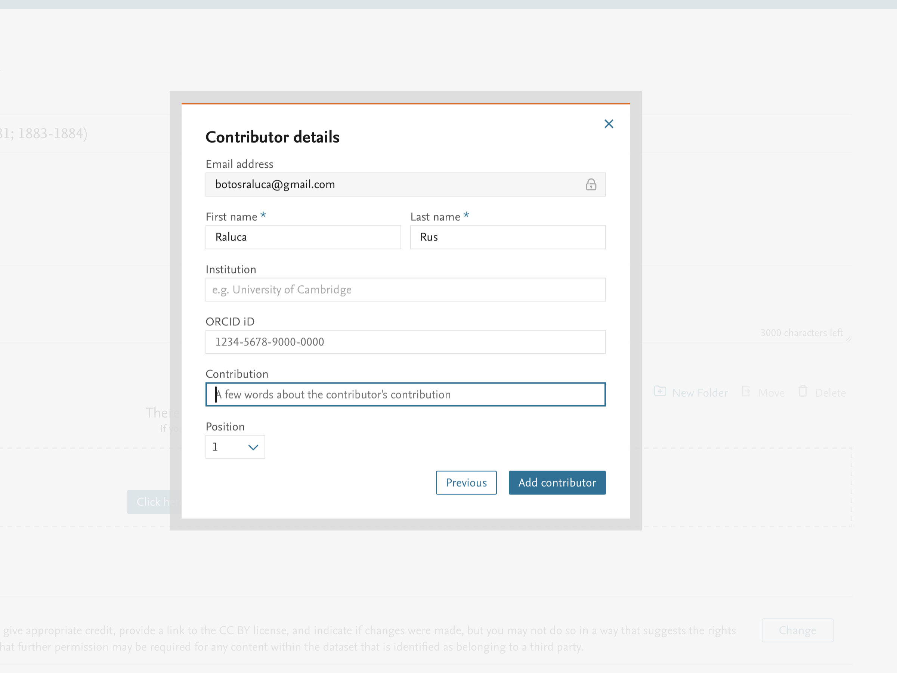
Enter information regarding the co-authors
Co-authors may also come from outside the UBB community.
You can also choose the co-authors' order

Slide 15
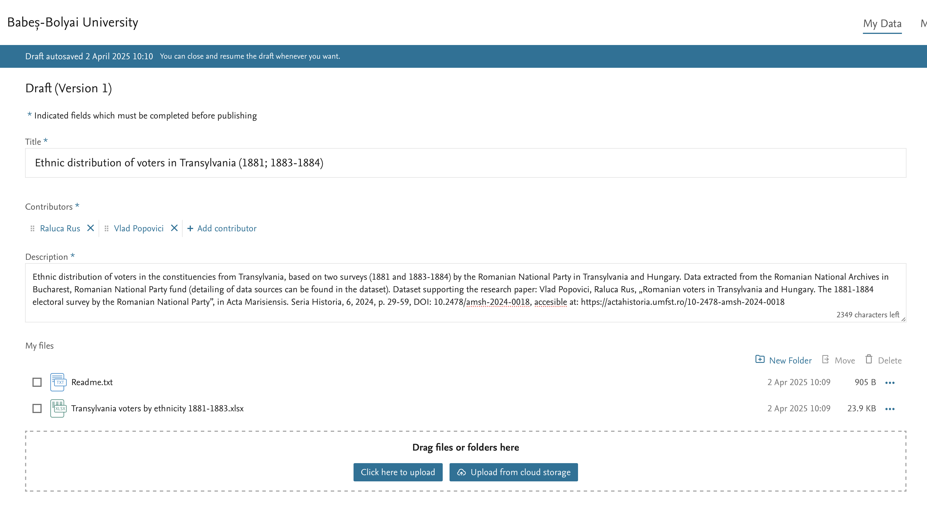
Datasets must be accompanied by a concise description, including mandatory bibliographic references to publications based on them.
From here, data files can be uploaded by dragging and dropping or by selection.
DCD-UBB recognizes and supports the data file types listed at this address: File Formats - Babeș-Bolyai University

Slide 16
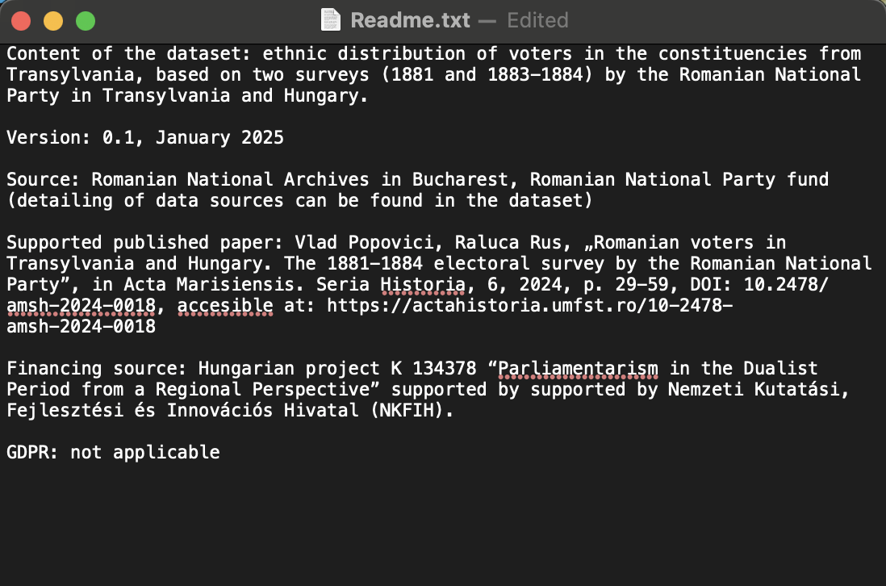
Datasets must mandatorily include a README file in .txt format, with UTF-8 character encoding, containing information regarding:
the content, authors, and version of the dataset;
the method of generation / sources of data compilation;
bibliographic references of publications based on the dataset (if applicable);
research funding sources;
any restrictions associated with the data, including GDPR-related ones.

Slide 17
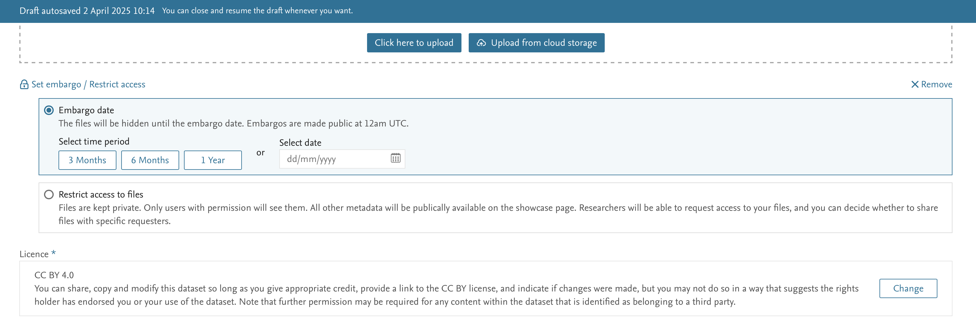
If desired or necessary, datasets
can be made publicly accessible only after a certain
period of time from their publication in the repository.
In such cases, only the title, authors, description, and
metadata will be visible prior to the embargo being lifted.
Access to files may be completely restricted
(i.e., for an indefinite period), in which case
the same elements as those of embargoed datasets will be visible (the title, authors, description, and metadata).
In both cases (embargoed datasets and those with fully restricted access),
third-party researchers may request access to the respective datasets from the authors,
with the decision in such situations remaining at the authors’ discretion.

Slide 18
The legal rights for access, use, and reproduction of datasets are established
in accordance with the Creative Commons, licensing, and can be set at the initial publication of the dataset or modified at any time thereafter.

Slide 19
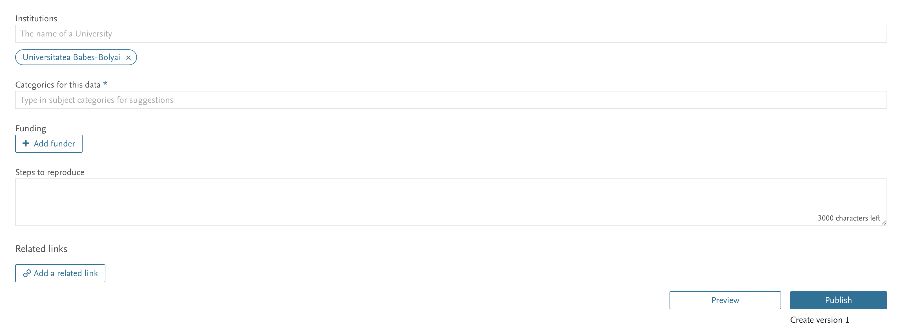
Other categories of metadata include:
- the institution(s) under whose auspices the dataset was created and published;
- information regarding tags (e.g., domains, topics, keywords) applicable to the data;
- information regarding the source / funding institution.
- information regarding the method of data generation and the steps required for their reproduction;
- links to other relevant digital objects/spaces related to the dataset (e.g., publications based on it).

Slide 20
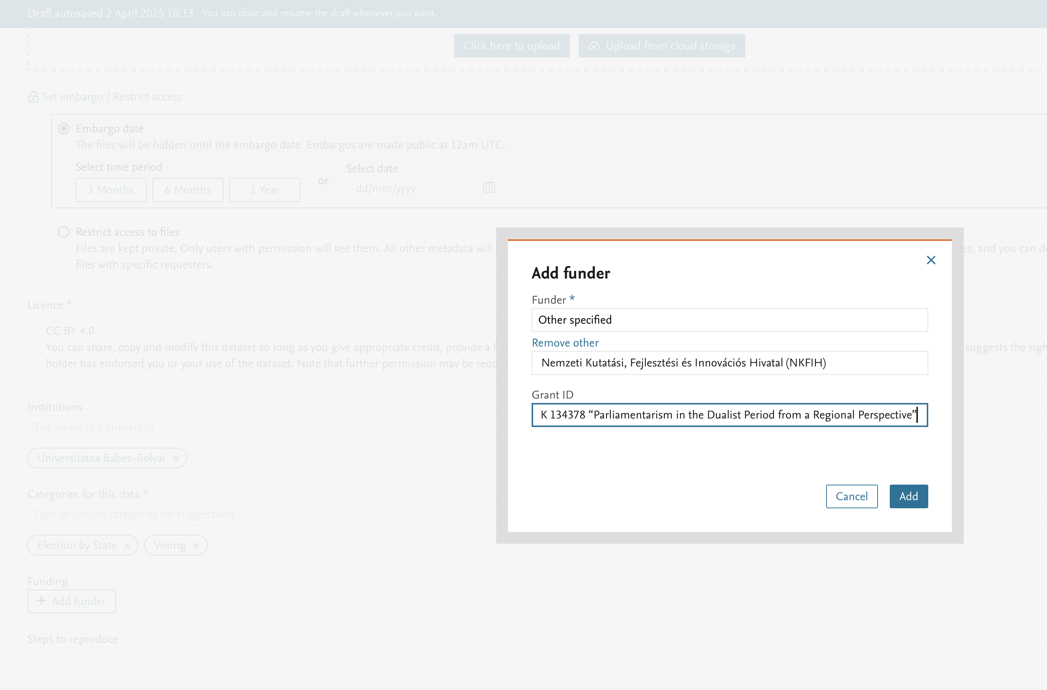
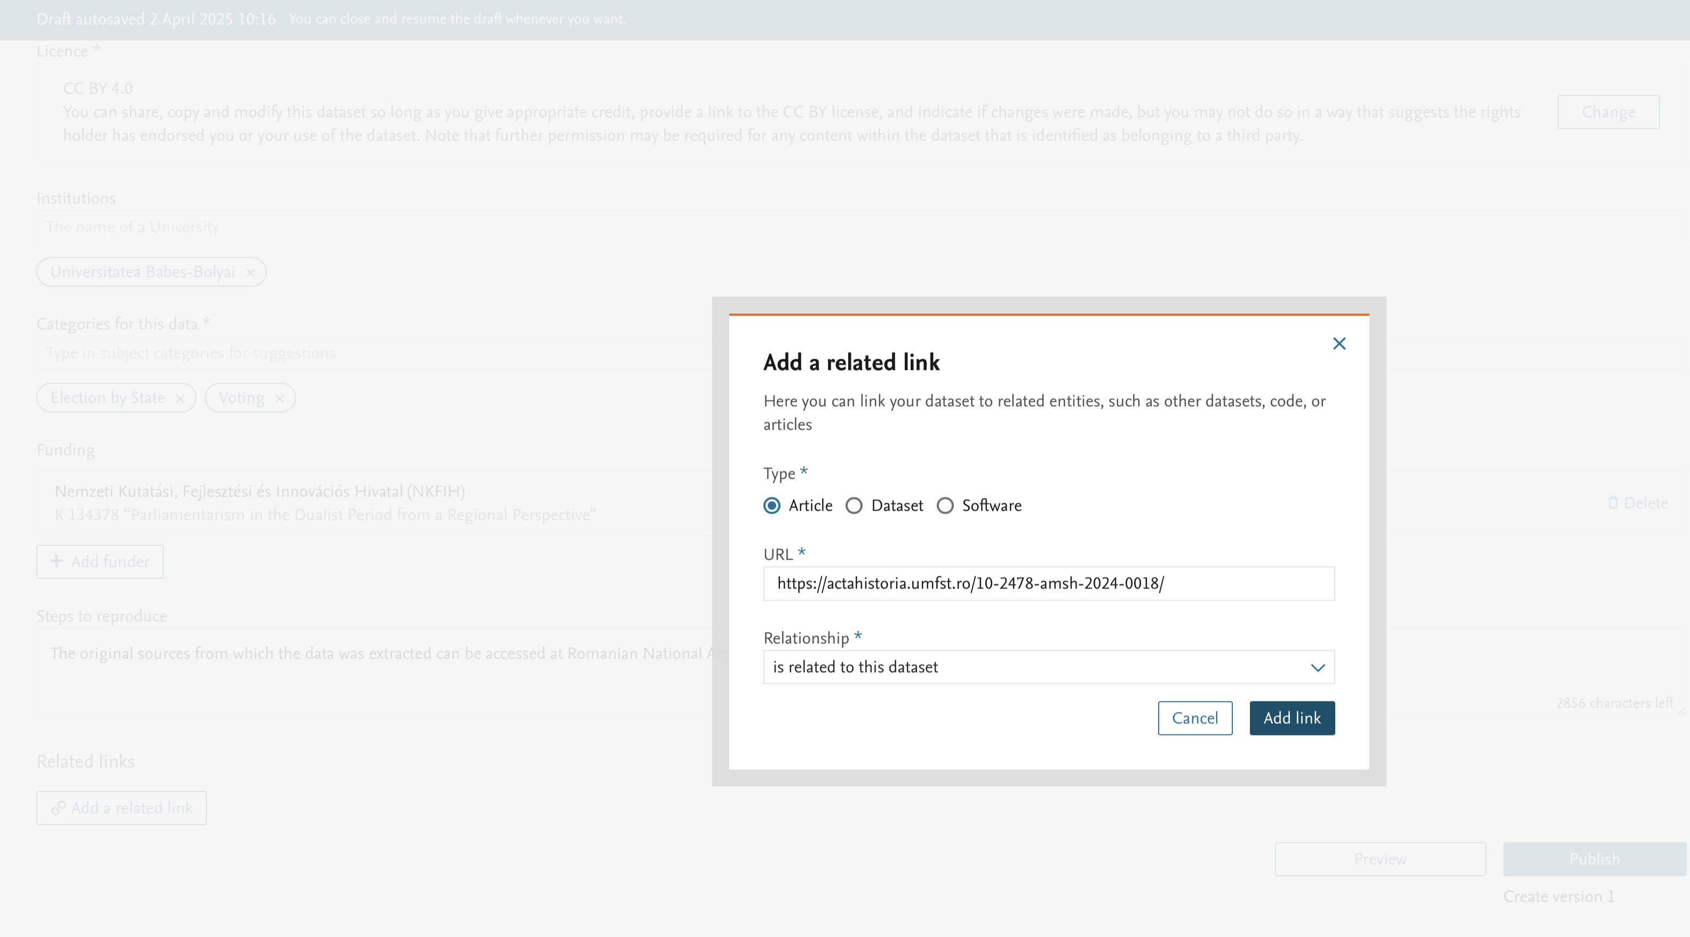
Metadata can be entered
either as textual information or
by selecting from a predefined list.

Slide 21
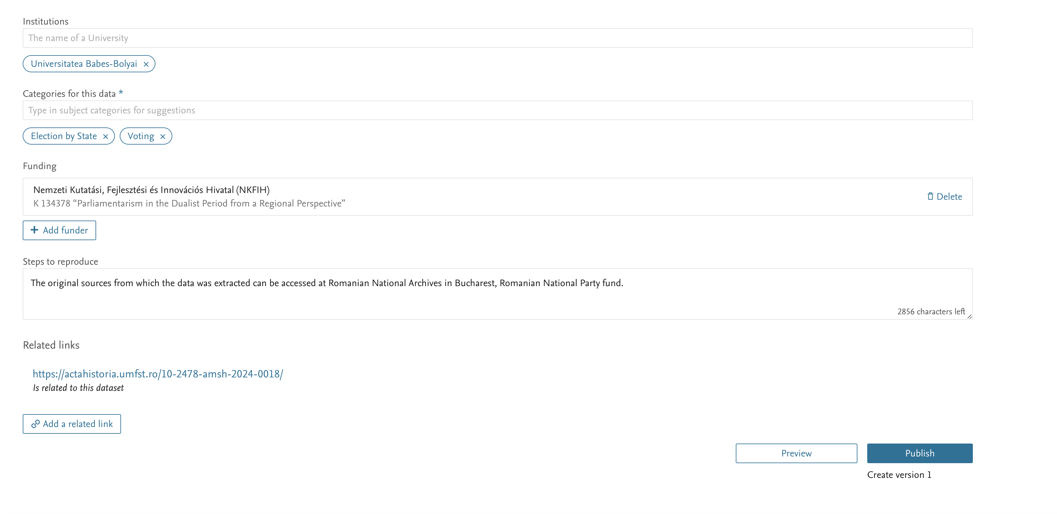
Before publication, the dataset and metadata can be previewed.

Slide 22
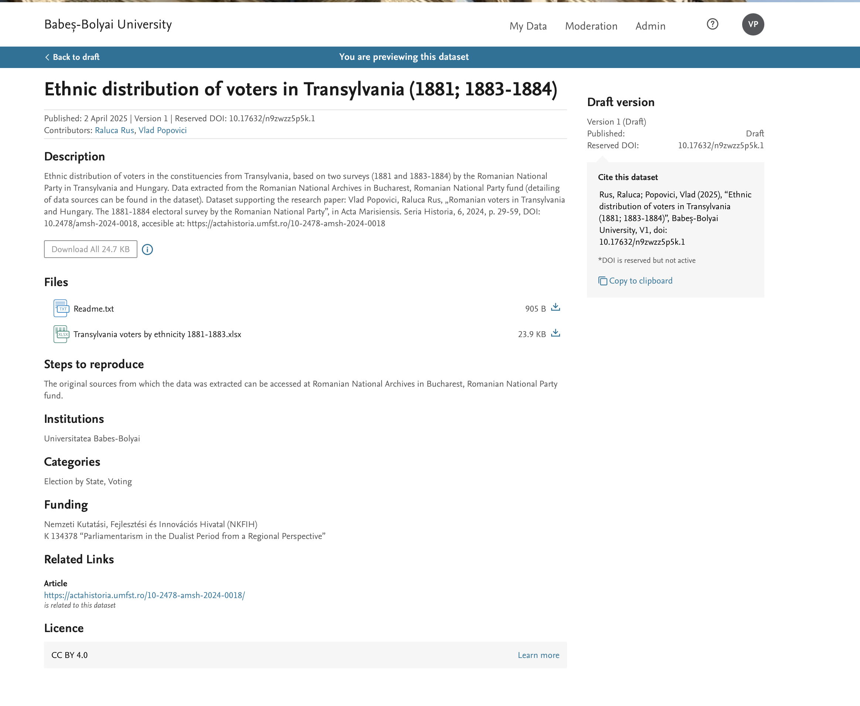
The preview also includes the citation format for the dataset, mentioning the authors, title, host institution, version, and the permanent DOI identifier.

Slide 23
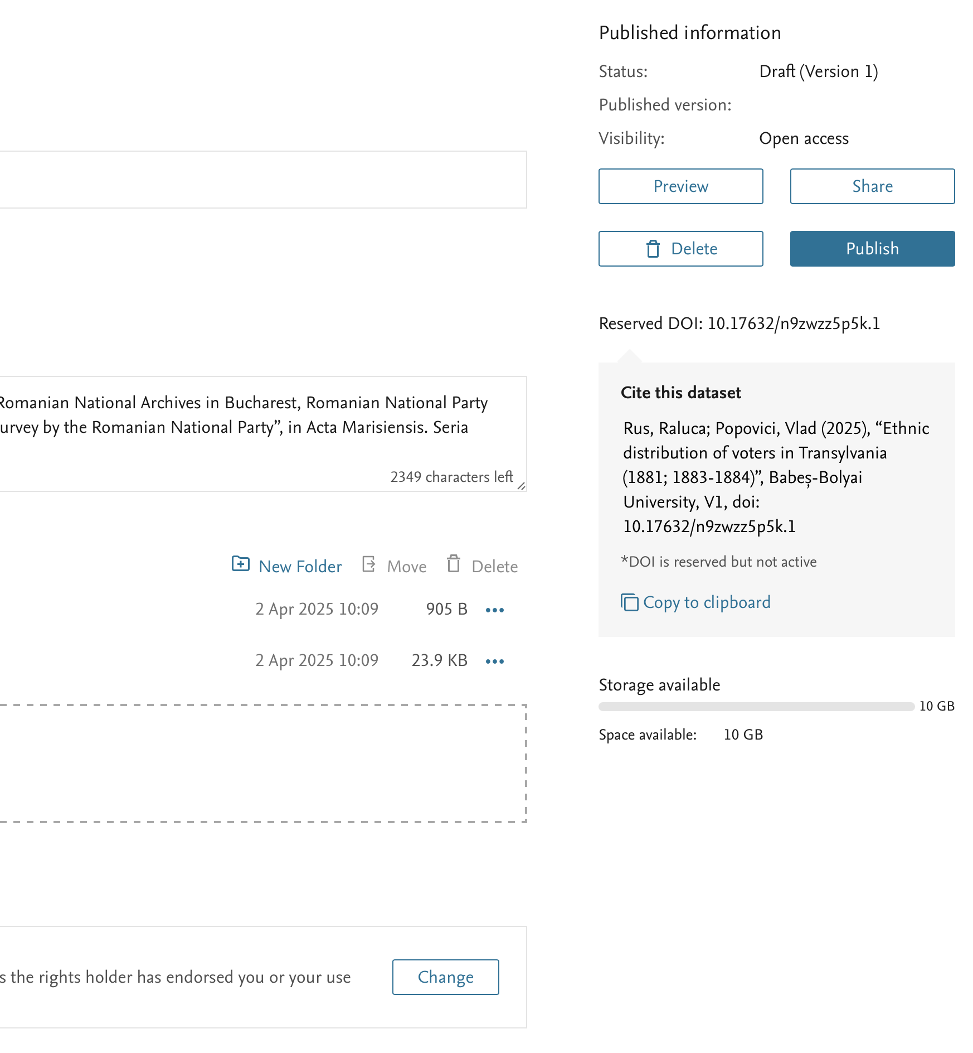
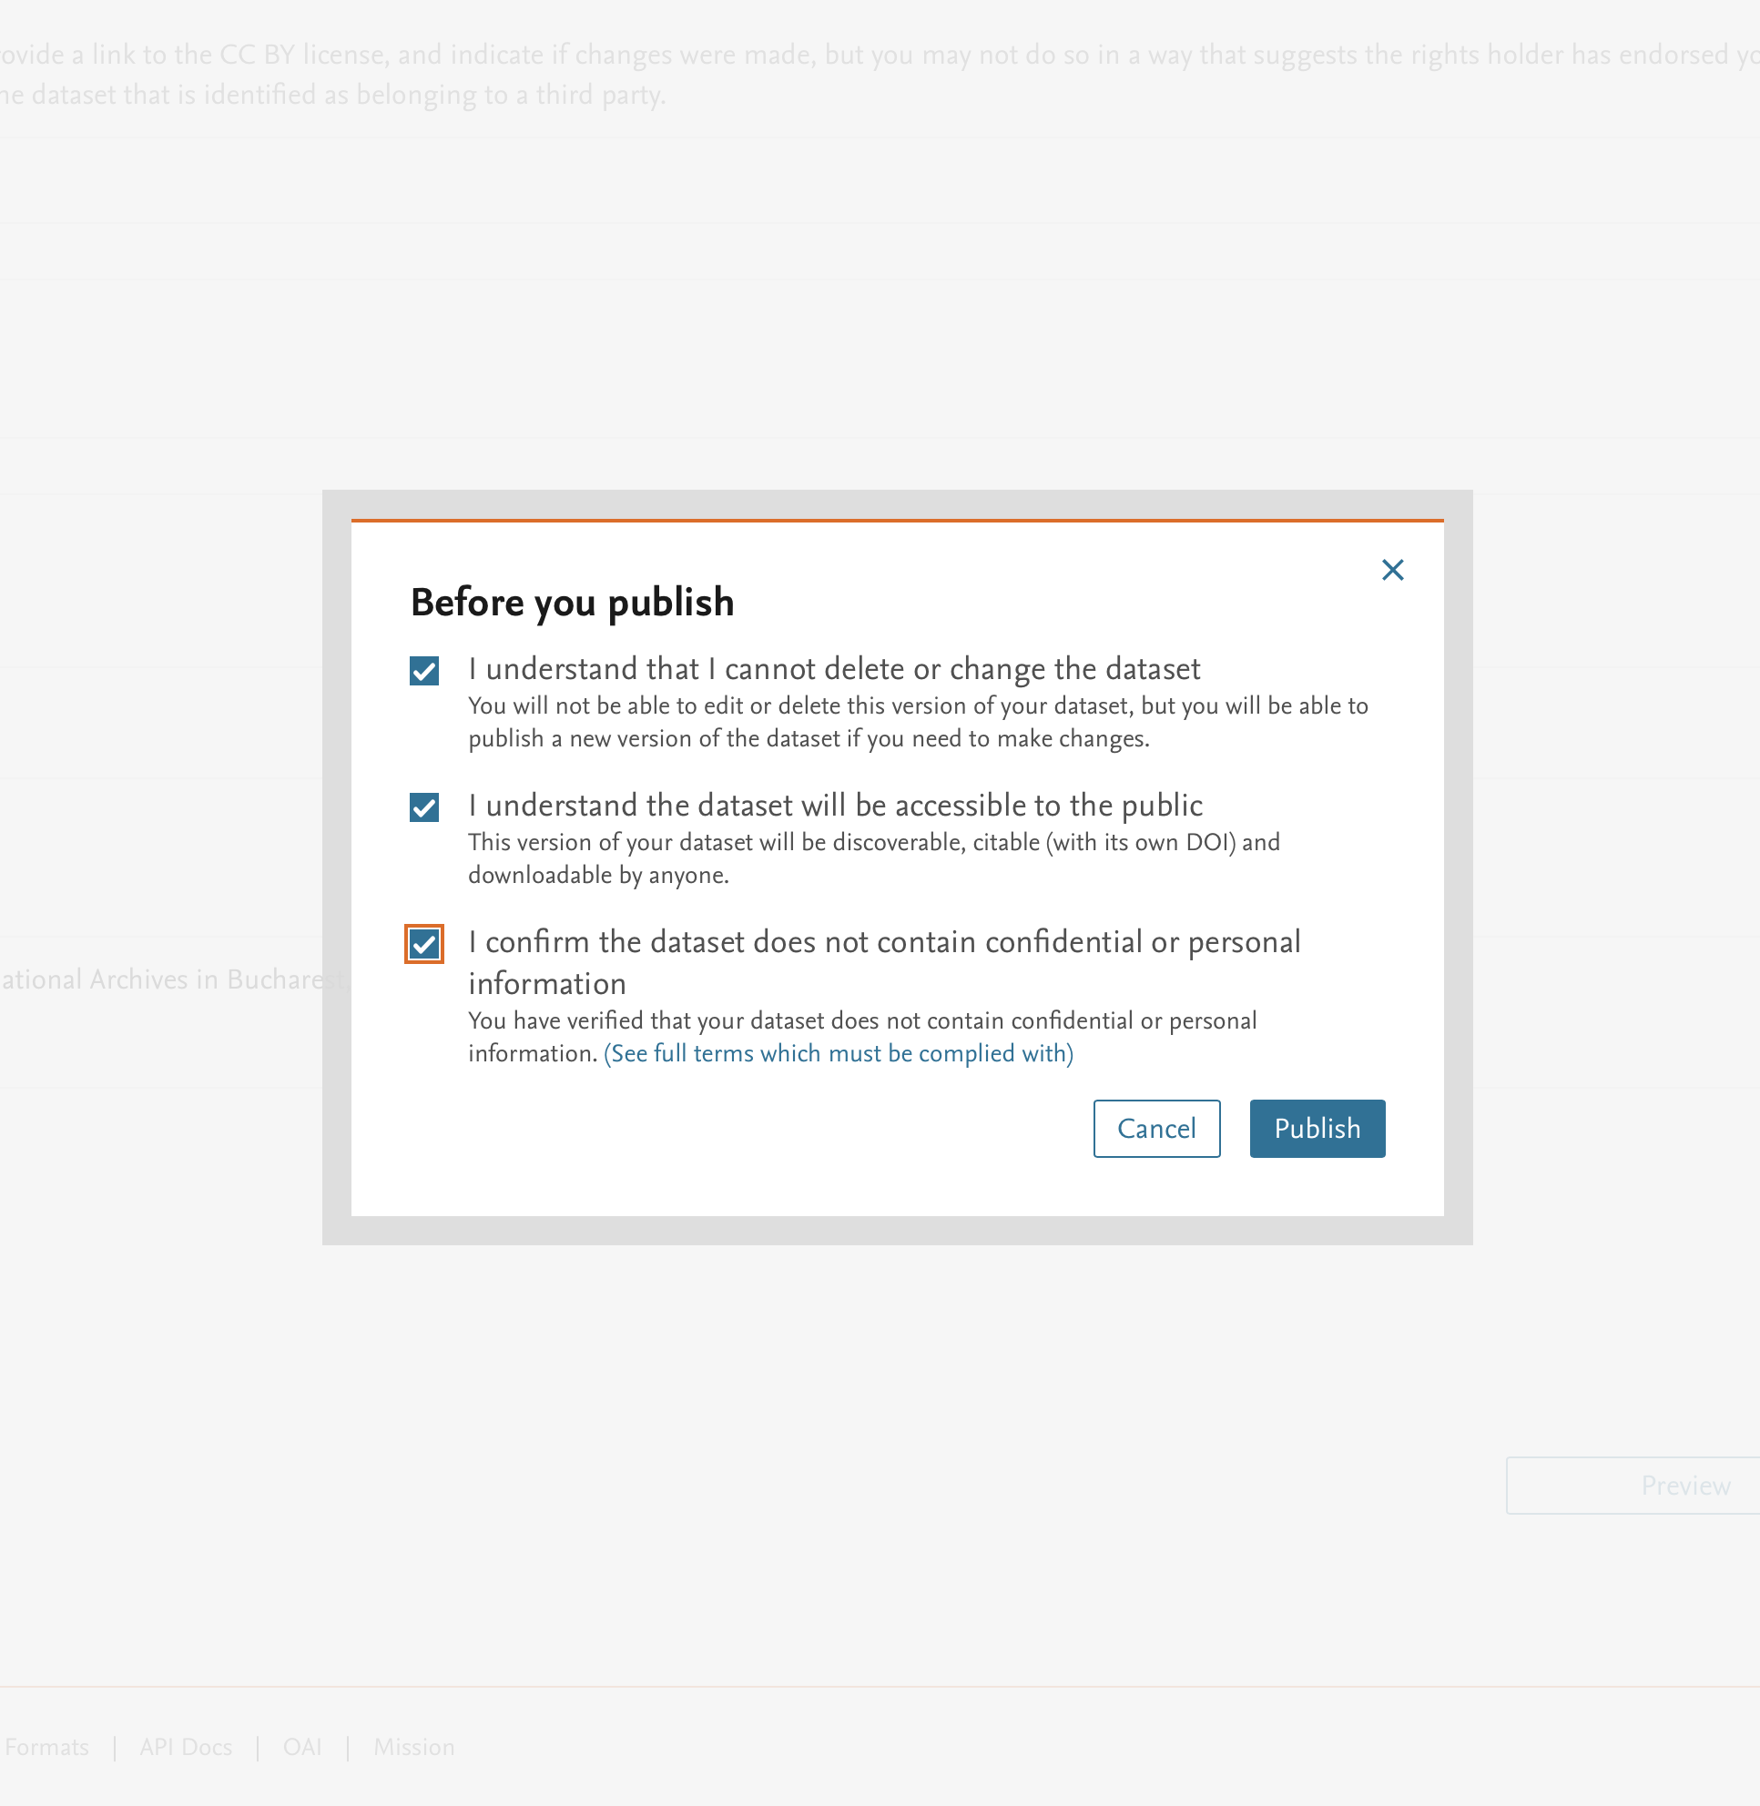
After verification, the dataset
can be published.

Slide 24
Once published (i.e., after acceptance by a DCD-UBB moderator), datasets can no longer be deleted.
Any modification to a dataset, no matter how minor, whether involving data files or only metadata, automatically results in the creation of a new version of the dataset and a new permanent identifier—thus, effectively, a new digital object.
The usage policies of DCD-UBB (see Section 5 below)
stipulate the mandatory acknowledgment of the origin/source of the data, and, in the case of data subject to GDPR, the anonymization of any information whose publication violates applicable legislation is required.
The publication of datasets whose generation or collection involved violations of applicable laws and/or the ethical and professional standards specific to scientific research is strictly prohibited.

Slide 25
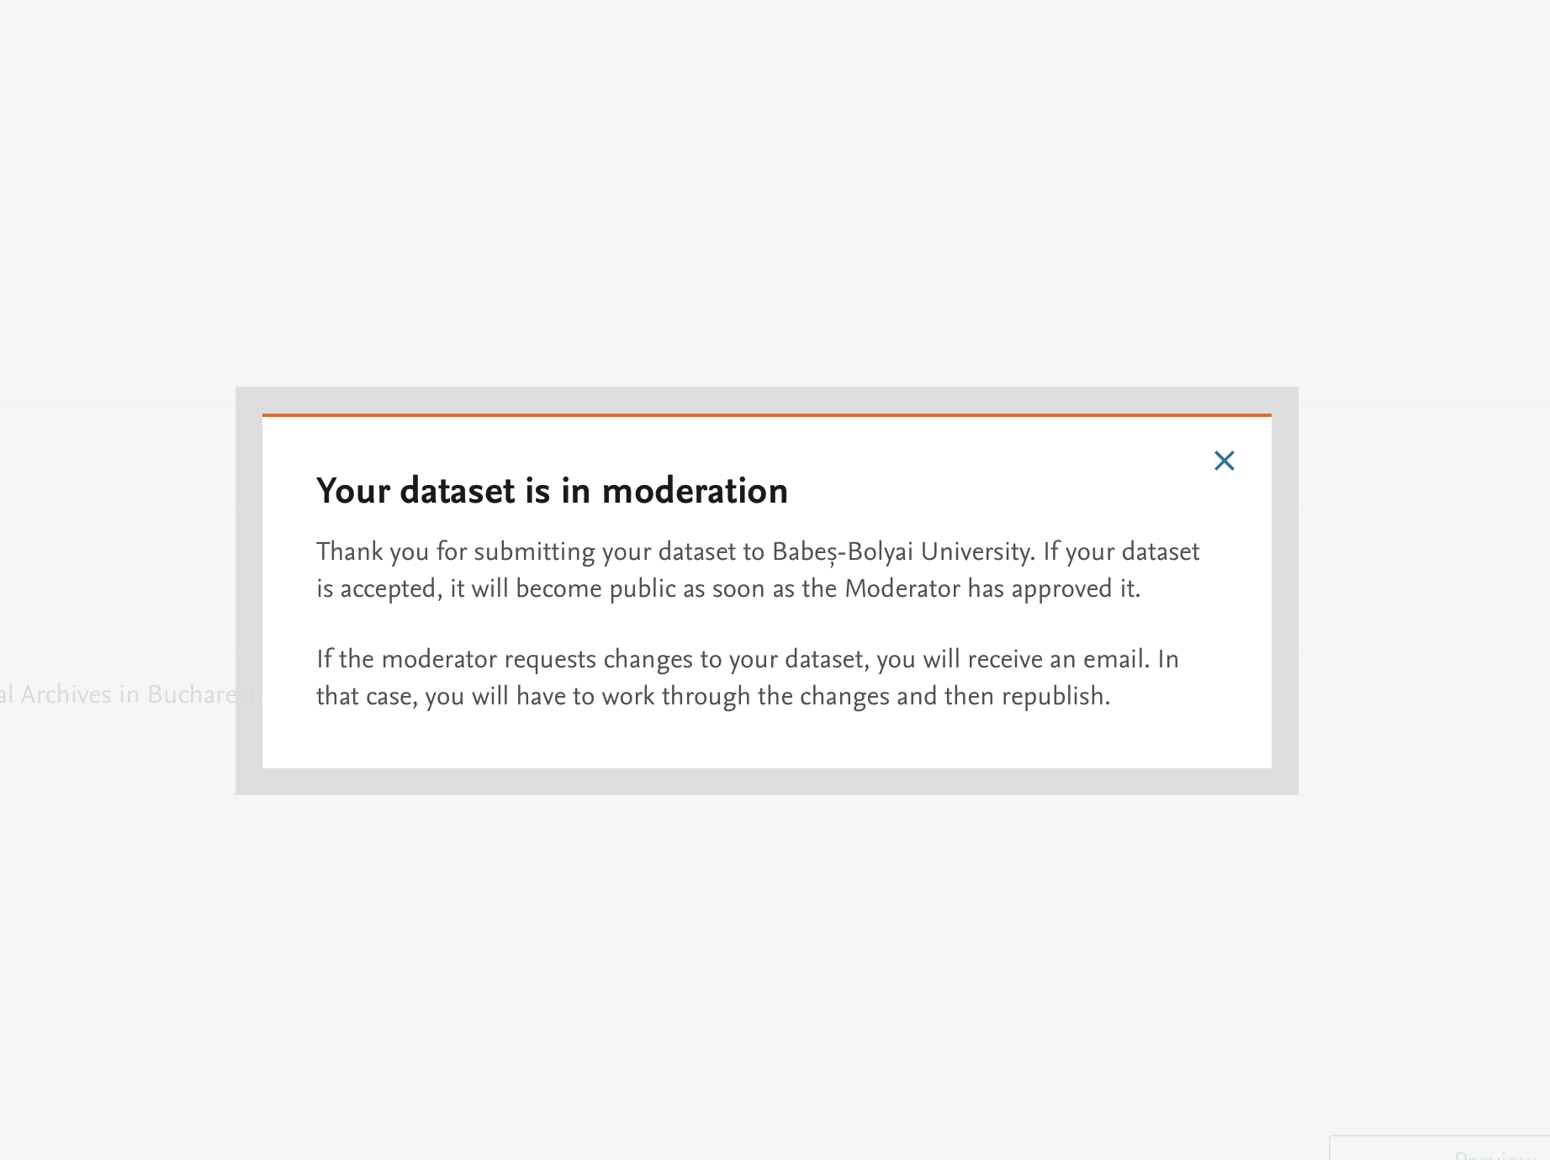
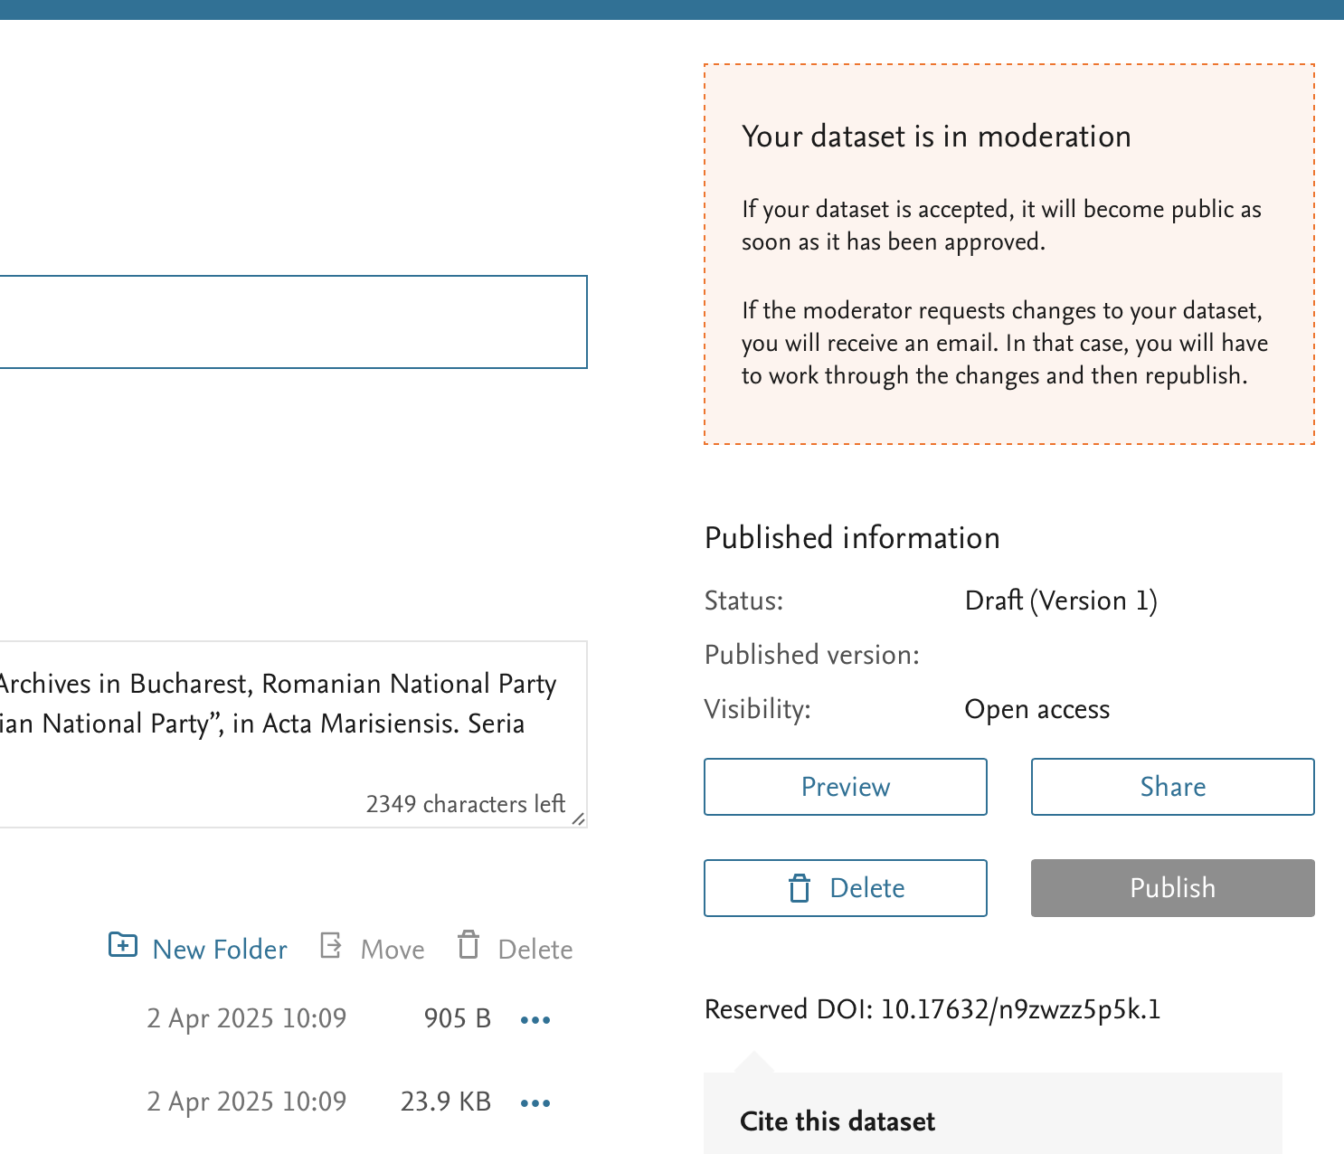
After submission for publication, the dataset is sent to a DCD-UBB moderator who verifies its compliance with technical requirements and the repository’s usage policies.
The moderation outcome may be:
Acceptance of the dataset as submitted;
A request for modifications to ensure compliance with technical requirements and/or usage policies;
Rejection of the dataset’s publication.
Options B and C must be accompanied by a written justification from the moderator.

Slide 26
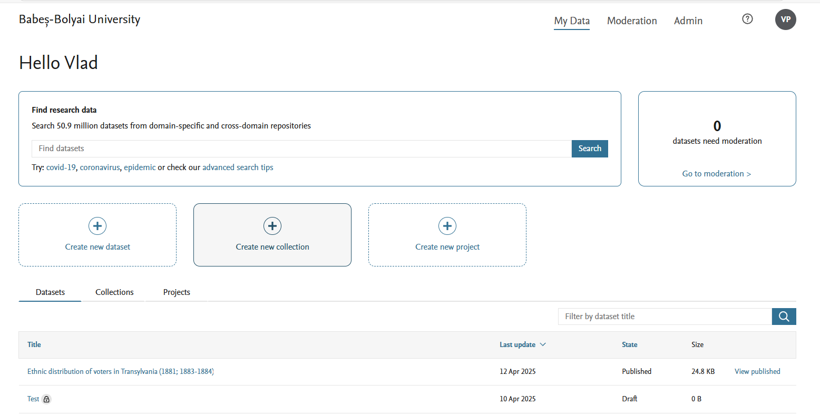
After the approval of the publication, the dataset will be visible in the authors’ list of datasets.

Slide 27
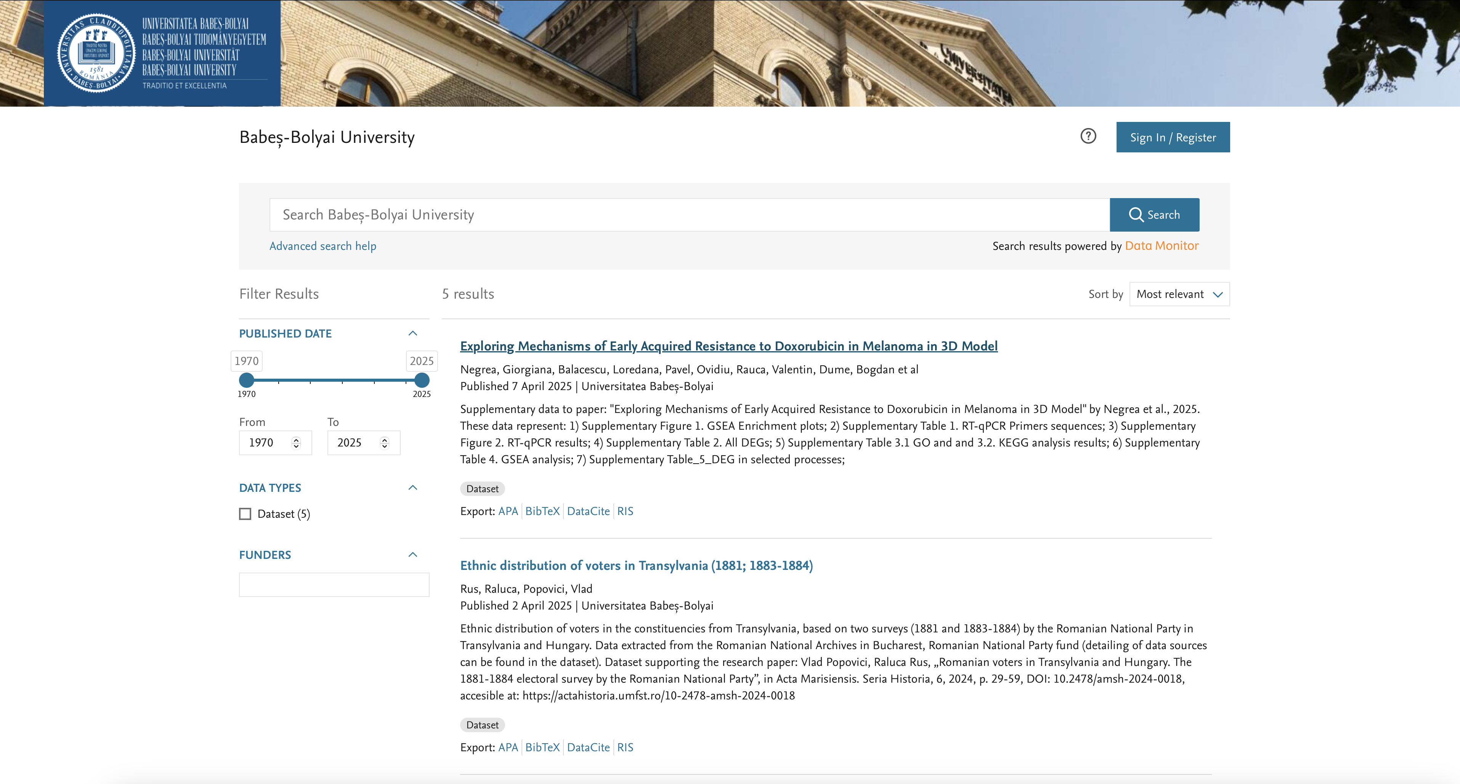
After the approval of the publication, the dataset will also be visible and searchable in DCD-UBB and Mendeley Data.
Please note: there may be a 24 to 72-hour delay between the approval of the publication and registration in DCD-UBB, due to the time required for information propagation within the repository’s database.

Slide 28
3. Registering a New Collection of Datasets

Slide 29
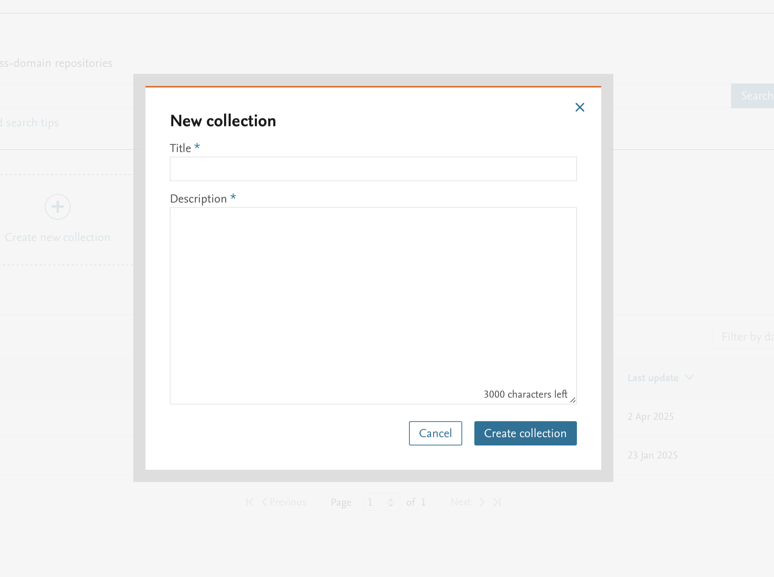
The title and a narrative description of the new collection are to be completed.

Slide 30
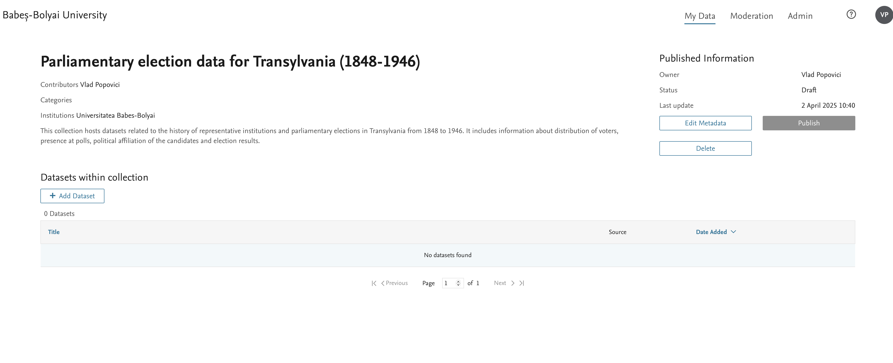
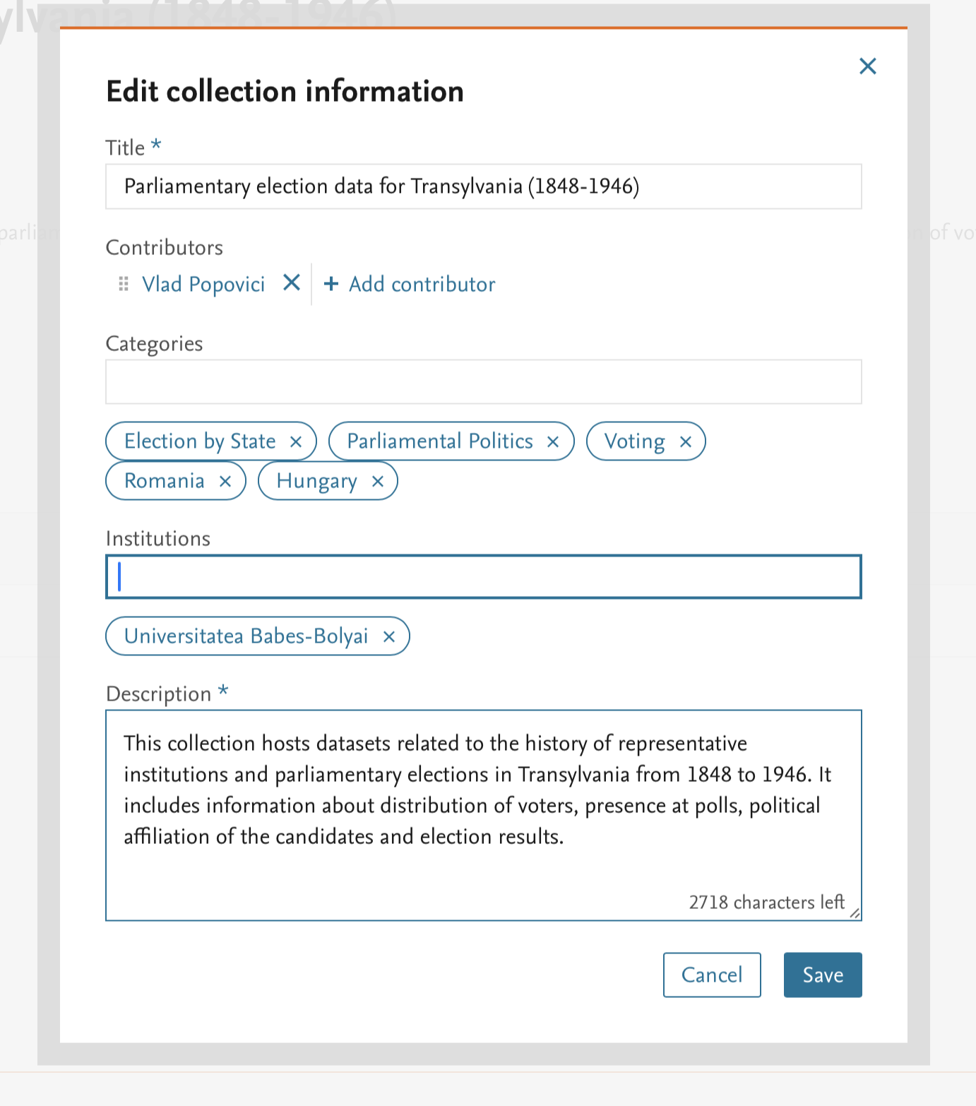
Once the new collection is created, datasets can be imported and the associated metadata can be edited.

Slide 31
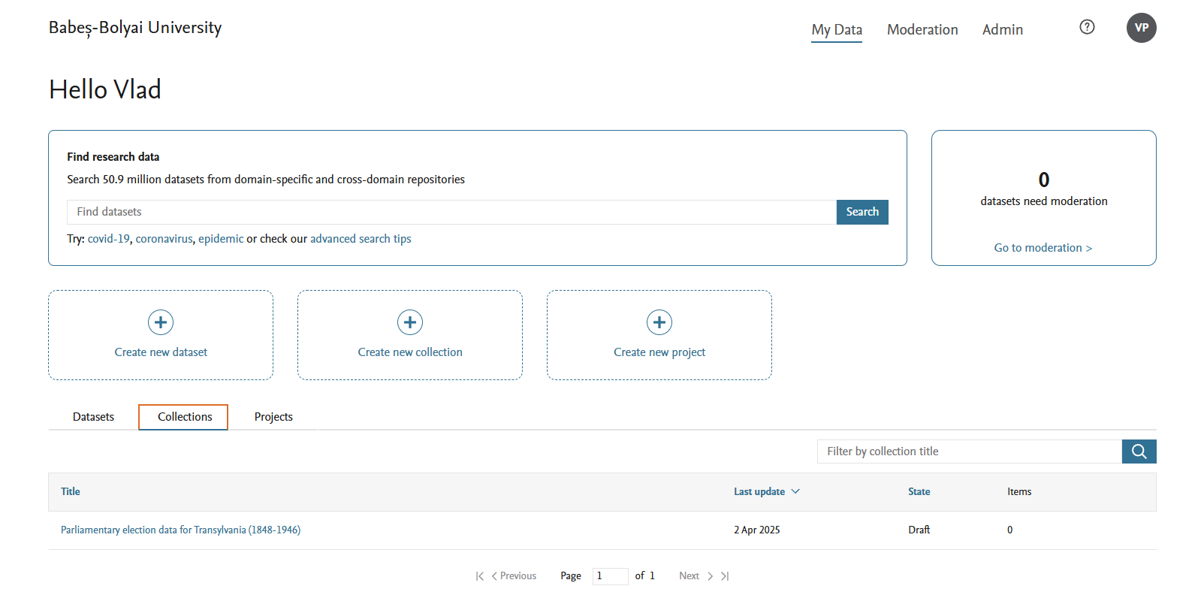
After publication, the collection becomes visible in the Collections section of My Data.

Slide 32
4. Registering a new collaborative project

Slide 33
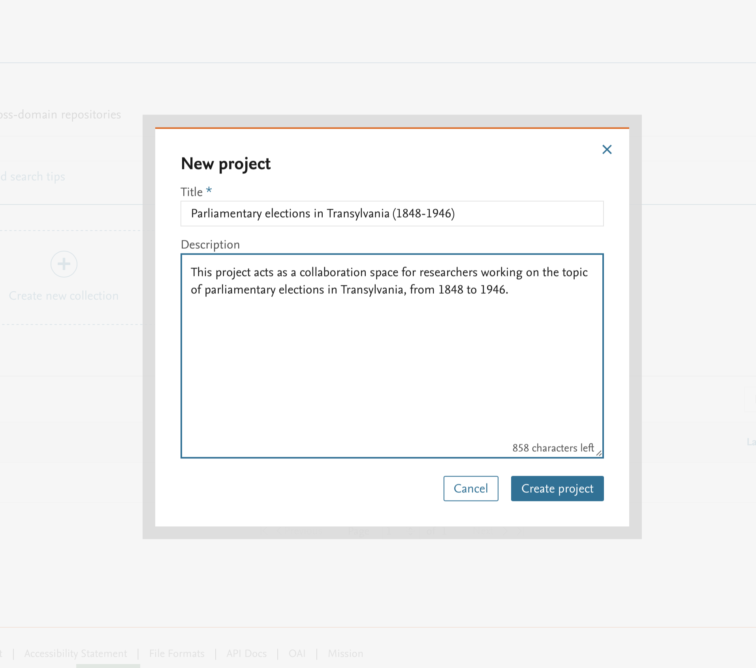
The title and a narrative description of the new collection are to be completed.

Slide 34
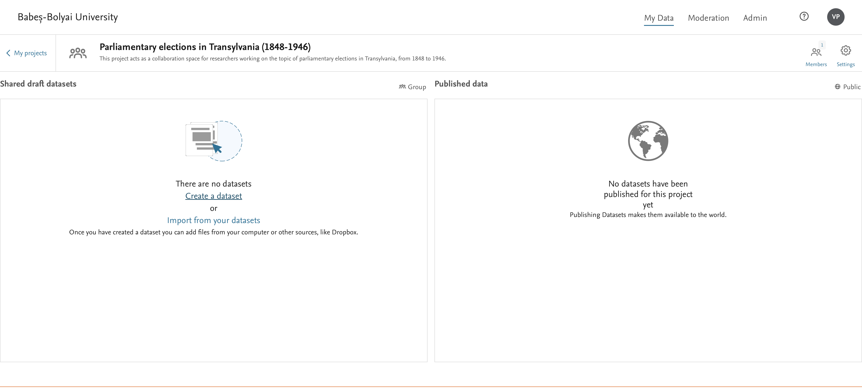
A new dataset is created, associated with the project, or an existing dataset is added.

Slide 35
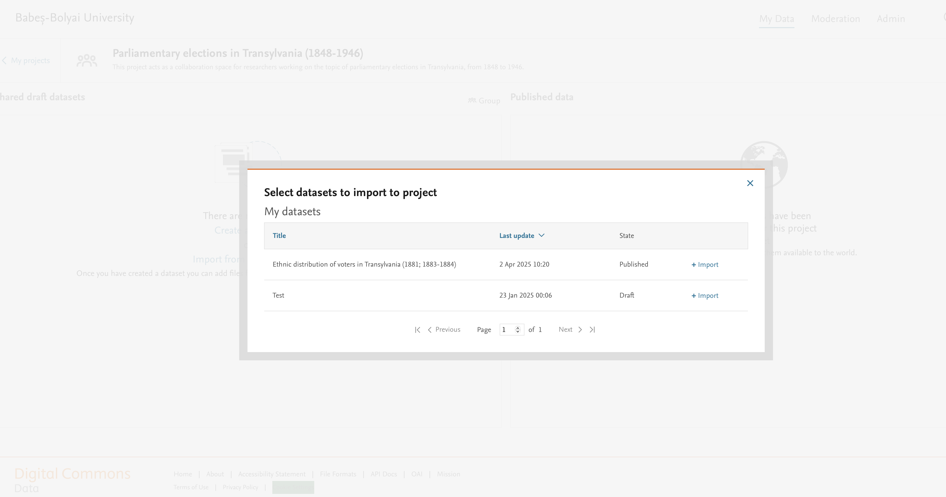
Datasets already uploaded to the repository by the project members can be added.

Slide 36
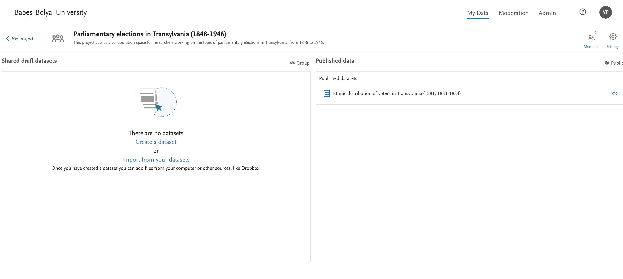
After being added, they will be visible in the project's control interface.
To add members to the project, access the dedicated interface.

Slide 37
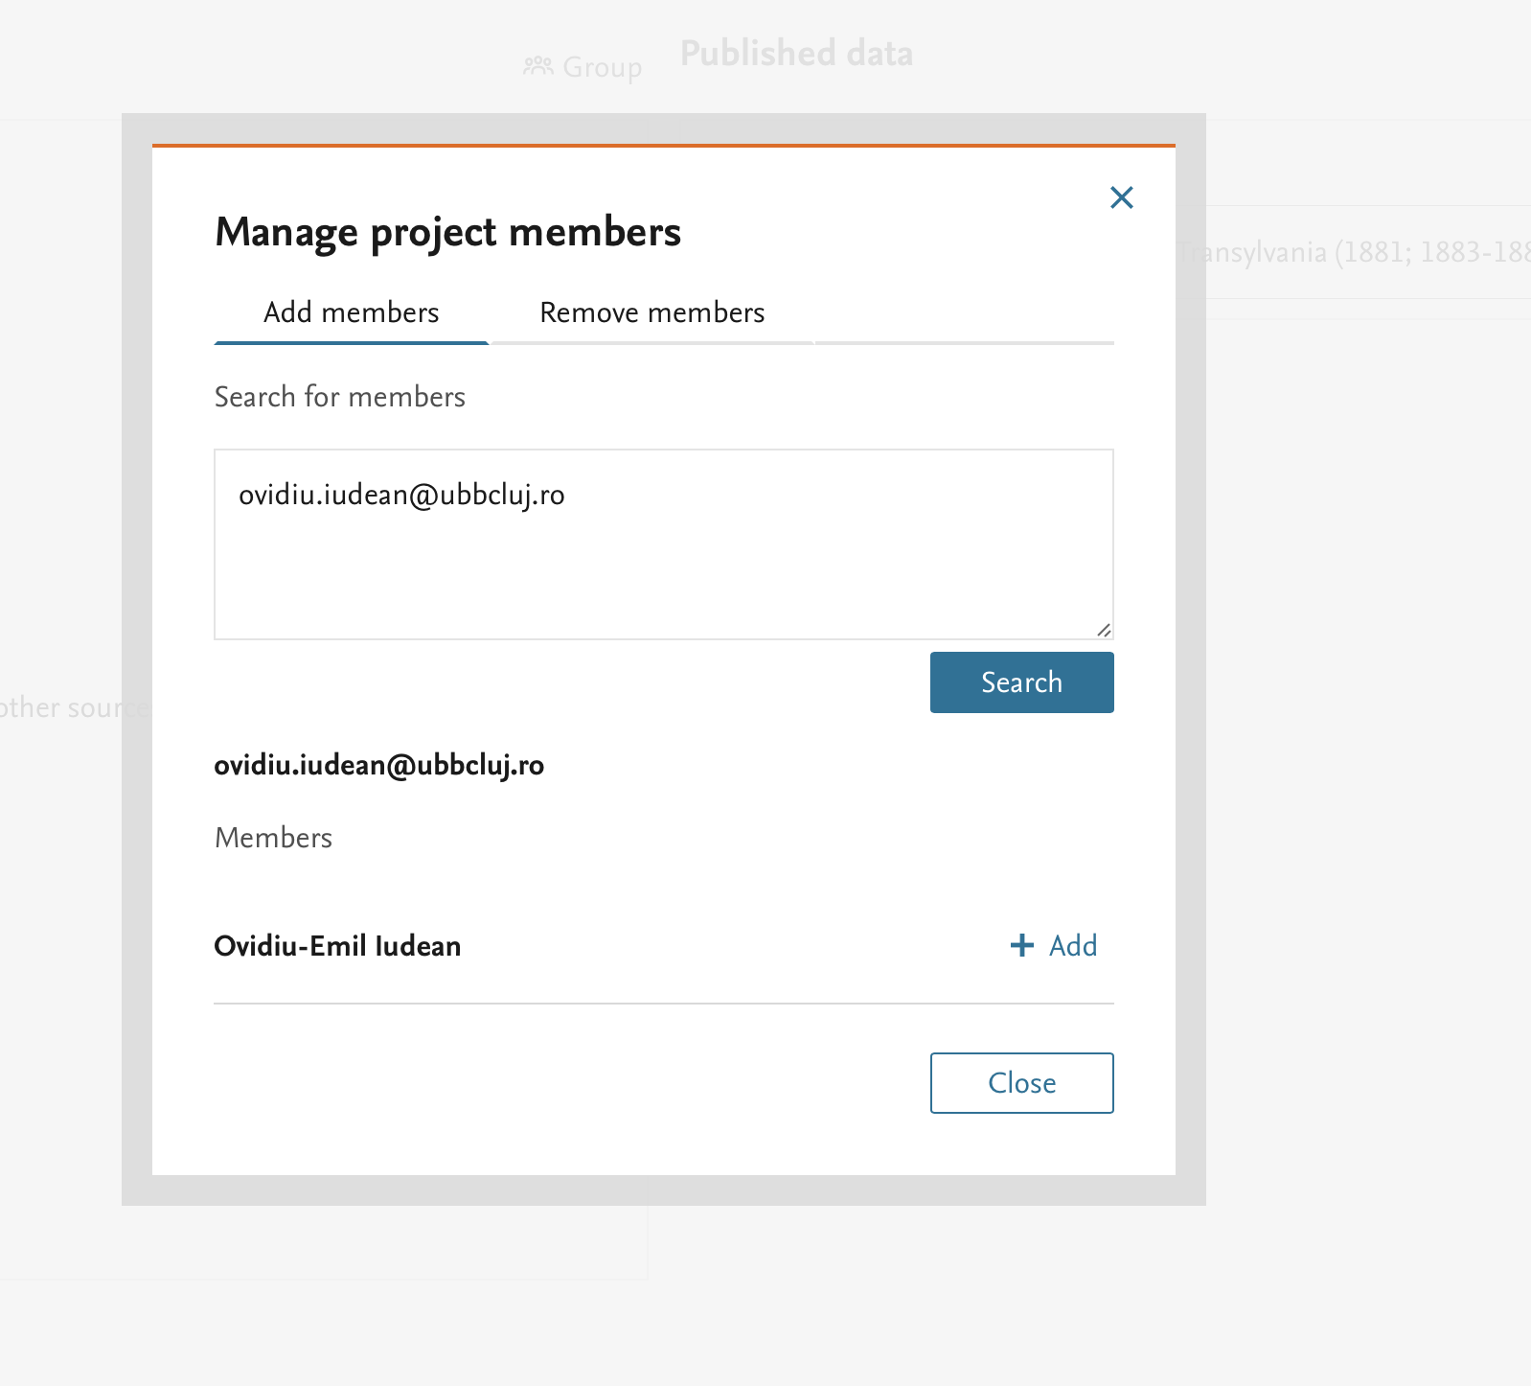
Members of a collaborative project on DCD-UBB must have an active email address in the @ubbcluj.ro domain or one of its subdomains (e.g., @econ.ubbcluj.ro, @stud.ubbcluj.ro).

Slide 38
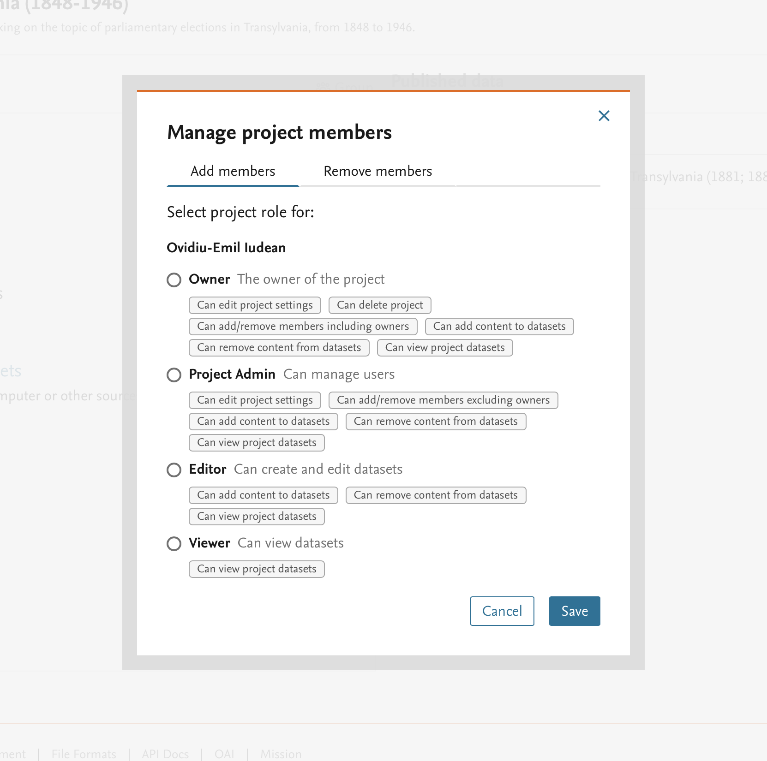
Newly added members can be assigned different roles in the project, with the corresponding permissions.

Slide 39
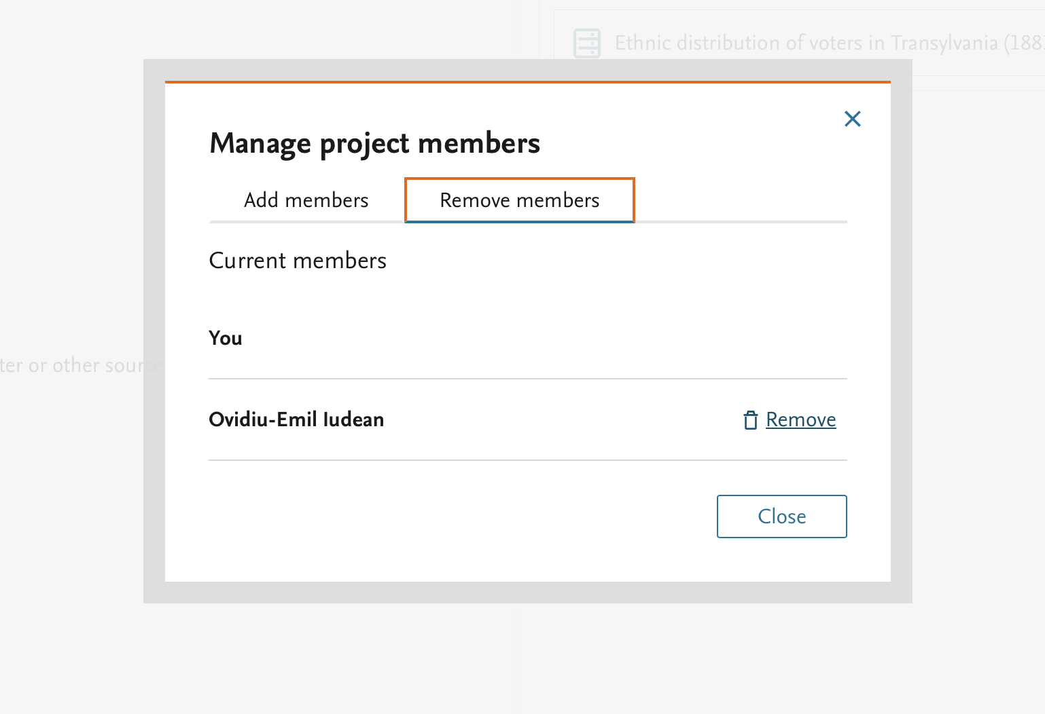
Members of a project can be removed from the same interface.

Slide 40
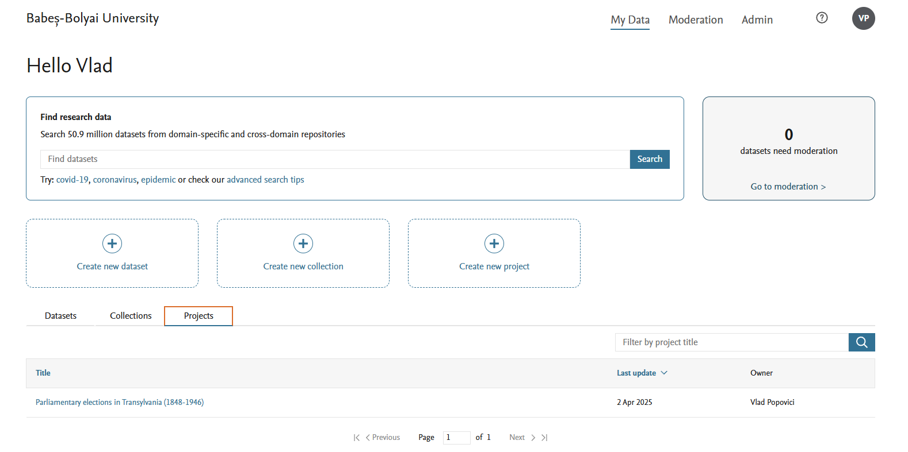
After publication, the new project will be visible in the list of projects for both the authors and the members.

Slide 41
5. Usage Policies for the DCD-UBB Data Repository
v. 0.3, 12.03.2025

Slide 42
1. Introduction and overview
Repository name: Digital Commons Data – UBB (DCD-UBB)
Description of the repository: Digital Commons Data - UBB is a storage platform for scientific data made available to the University Babeș-Bolyai Cluj-Napoca (UBB), for a fee, by Elsevier.
Coordinator: Lector Dr. Vlad Popovici
Scope of the repository: collection, storage and sharing of scientific datasets from all academic domains, in compliance with the legal and ethical requirements contained in the UBB Data Privacy Policy.

Slide 43
2. Good practices in scientific research
National normative framework: as datasets are the results of scientific research activities and support this type of activities, we recommend that any research, whether it produces or only uses datasets, should be preceded by familiarization with good practices in the field, as they are regulated at national level (e.g., the Guide for integrity in scientific research, the Framework Code of Ethics and University Deontology) and internally, at UBB level (e.g., the Framework Code of Ethics and University Deontology, the recommendations of the Scientific Council of UBB).
International regulatory framework: we recommend, prior to the research, familiarizing yourself with the specific requirements of the scientific journals/publishers in which you intend to publish your results, especially those related to obtaining ethical approvals and those related to data collection and management. The use of checklists from international institutions may be useful in this respect (e.g., U.K. Research Integrity Office; University of Cambridge, Good Research Practice Checklist; Harvard University, Researchers Checklist).

Slide 44
3. Data collection
Types of data: scientific datasets from a variety of fields, including but not limited to: experimental, statistical, observational data, transcripts and datasets obtained by compiling information from primary or secondary sources, images or audio-visual data.
Sources of data: individual or collaborative research by members of the UBB community, internal teaching and research structures (faculties, centers, research units), teams of research projects carried out under the aegis of UBB, external specialists (national or international) who carry out research activities in collaboration with members of the UBB community or within the framework of projects carried out under the aegis of UBB.
Previous publication: Datasets must not have been previously published. Datasets that already have a DOI in another data repository are not accepted. Updated versions of other datasets may be published only with a detailed description of the updates in the corresponding README file and with the dataset they update indicated by its DOI or identifier

Slide 45
3. Data collection
Data Citation: each dataset will necessarily contain information on the source of the data.
Depending on the type of data, the process of acquisition (generation/collection) and the specificity of the scientific domain, the source information may be integrated into the file containing the dataset, or into the associated README file (see below: Documentation and Metadata)
Data formats: to ensure harmonization of datasets with FAIR principles, we recommend the use of formats that allow for re-use and integration in further research: https://opendata.openscience.ubbcluj.ro/file-formats.
Executable files: uploading executable files is not supported.

Slide 46
3. Data collection
Archived files: it is recommended to avoid uploading files in archived format. If, for compelling reasons, it is necessary to upload data in archived format, it must be accompanied by a README file containing a general description of the contents of the archive and the reason for archiving.
Data sizes: DCD-UBB allows the upload of datasets with a maximum size of 100 GB / dataset.
Data moderation: datasets proposed for hosting in DCD-UBB will be checked in advance by one of the moderators of the repository. In case technical, content or legal issues are identified that require additions, modifications or verifications, the author of the dataset will be notified to resolve them and the publication of the dataset will be conditional on the resolution of these issues.

Slide 47
4. Data storage and security
Storage location: secure Amazon S3 servers, located in Ireland, provided by Elsevier.
Backup plan: automatic daily backup, with indefinite backups kept indefinitely via Data Archiving and Network Service, in the Netherlands. In the event of contract termination, all datasets in DCD-UBB will be automatically exported to Mendeley Data (repository also managed by Elsevier), following the same operational procedures as Digital Commons Data.
Backup limitations: when transferring datasets from DCD-UBB to Mendeley Data, the maximum limit of a dataset will be reduced to 10 GB. Datasets exceeding this size will be kept until the size is readjusted.
Security measures: the security of the platform is ensured by Elsevier. User access to the platform is controlled by authentication based on a UBB institutional account.

Slide 48
5. Documentation and metadata
General: datasets are required to have an author(s) and a title. The data must be scholarly in nature and consist of structured information supporting the research, not published research results. The DCD-UBB is a data repository, not a repository of scientific publications.
Documentation: each dataset will include a README file describing the content, format, collection methodology and version. A new README file will be made for each subsequent version of a dataset.
Data quality: the consistency and quality of data collection will be checked by the author(s) before being made public, and the checking process will be documented. The application of data quality checking processes (e.g., calibration, sampling, repeated measurements, standardized data capture, data entry validation, peer review or representation using controlled vocabularies) will be explicitly mentioned in the README file of the dataset

Slide 49
5. Documentation and metadata
Coded data: if the information in the datasets has already gone through the coding process, we recommend uploading the coding system (codebook) used as part of the dataset.
Acknowledgments, credit and thanks: if the creation of the dataset involved research funding (from whatever source), logistical and institutional support or know-how without which the dataset could not have been generated, these should be explicitly mentioned in the README file, part of the dataset.
Metadata (compatibility): Metadata for Digital Commons repositories are available in Dublin Core and Schema.org formats respectively and are compliant with the Google Dataset standard.
Metadata (typology): DCD-UBB offers the possibility to use the following metadata types for describing a dataset: title, author(s), CC license, institutions under whose auspices the cob research was conducted, keywords ("categories"), funding source, narrative description (max. 3000 characters), replication instructions (max. 3000 characters), associated links.

Slide 50
6. Data sharing and access
Sharing policy: data will be available to the general public, except for data containing sensitive or personal information.
Identification methods: Each dataset receives a permanent identifier in the form of a Digital Object Identifier (DOI) at the time of publication. Once published and identified by a DOI, a dataset can no longer be deleted from the repository. For each subsequent version of a dataset, a new DOI will be generated.
Data access: access to the data hosted in DCD-UBB is configured by the author who uploads the dataset. The data can be fully public, associated with a temporal embargo (a predefined period after which they become public), or can be accessible only as metadata. In the latter case, users interested in that specific dataset can contact the author directly to request access.
Access restrictions: Data subject to GDPR will be available only in anonymized form (see below: GDPR compliance and data anonymization).
Access platform: The repository will be accessible through the web portal of Babeș-Bolyai University of Cluj-Napoca, at the following web address: https://opendata.openscience.ubbcluj.ro/research-data.

Slide 51
6. Data sharing and access
Data ownership: DCD-UBB is a storage tool provided to the UBB community and its collaborators by the University, following a commercial agreement with Elsevier. The ownership of data uploaded to DCD-UBB remains with the authors designated as such in the description of the datasets or with the institutions that funded the collection and compilation of the data, under the legal conditions stipulated in the contracts between the authors and the corresponding institutions. By using the Creative Commons licenses provided by DCD-UBB, authors can decide on the ways their data are used, both commercially and non-commercially, including ownership rights after third parties access the data from the repository. If there are particular aspects of data ownership applicable to only some of the authors of a dataset, these aspects must be mentioned in the README file of the dataset.
Licensing data use: Through DCD-UBB, a set of Creative Commons licenses are made available to authors that can be used to legally regulate the subsequent scientific and commercial takeover, use and citation of data.
Citation of data by third parties: citation of datasets will include information regarding: Author, Title of the dataset, DOI, Data access – adapted according to the specific requirements of the publication in which the citation is used.

Slide 52
7. GDPR compliance and data anonymization
General legal aspects: The proposed datasets to be uploaded must adhere to the legal provisions in force in Romania and the European Union at the time of compilation and at the time of their publication in the UBB Data Catalogue (DCD-UBB), regarding intellectual property rights and sensitive personal information. Dataset authors are encouraged to verify that the data collection, compilation, and public sharing operations are consistent with UBB’s Data Privacy Policy and that they adhere to the provisions of the UBB Code of Ethics and Professional Conduct.
Personal informations: Datasets containing personal information subject to the GDPR must be anonymized before being included in the repository.
Anonymization techniques: The anonymization method is determined by the dataset author, depending on the nature of the information it contains. DCD-UBB accepts datasets anonymized through pseudonymization (with a recommendation to use numeric pseudo-identifiers), aggregation, generalization, substitution (including synthetic data). The README file accompanying the dataset must explicitly state the anonymization technique used, the rationale for its selection, and any potential implications for subsequent data analysis.

Slide 53
7. GDPR compliance and data anonymization
Subjects' consent: Where necessary, authors must provide evidence of having obtained informed consent from the subjects whose information is included in the repository. The consent forms themselves are not to be uploaded to the repository, but their existence must be explicitly mentioned in the README file accompanying the dataset. The dataset authors are responsible for providing these consent forms for verification at any time after the dataset has been made public.
Status of restricted-access datasets: the former provisions apply mandatorily to all datasets proposed for hosting in the repository, regardless of the access model (fully open, embargoed, restricted), except for datasets for which the author has chosen to upload only the metadata to the repository.
Data anonymization verification: The DCD-UBB repository allows the publication of datasets only after they have undergone a moderation process. The administrators and moderators of DCD-UBB are responsible for verifying that the datasets proposed for publication adhere to the GDPR regulations. In cases where issues requiring modifications are identified, the datasets will be returned to the authors and will not be published until the identified issues have been resolved.

Slide 54
8. Data Retention and Archiving
Retention Period: Datasets will be retained in the repository indefinitely.
Archiving Strategy: Datasets will be preserved in the repository in the form in which they were originally published. Any subsequent changes (i.e., new versions) will result in the creation of new permanent DOI identifiers for the respective dataset, effectively creating a new dataset. In the event that the contractual relationship between UBB Cluj-Napoca and Elsevier ends, the datasets will be transferred to Elsevier’s Mendeley Data repository, remaining publicly accessible under conditions similar to those of DCD-UBB. Backup copies of the datasets will be retained indefinitely through the Data Archiving and Network Service (DANS) in the Netherlands.

Slide 55
9. Responsibilities and Roles
General Responsibility: Babeș-Bolyai University of Cluj-Napoca, through the Office for Open Science (OȘD) and the North-West Regional Center for Researcher Career Orientation (UBBCORE), will oversee all activities related to the management of datasets in compliance with legal provisions, institutional regulations, and current scientific standards.
Individual Responsibility: DCD-UBB users assume responsibility based on their role in the creation and publication of data.
Roles: DCD-UBB users may hold one of the following roles:
Data curator (administrator, moderator)
Data author (UBB author, external collaborator)
Third-party user
Administrator: The administrator role provides access to all information within DCD-UBB, including management of all datasets and the publication process, making web design changes, controlling audit files of platform activity, and communicating with users in other roles as well as with Elsevier representatives who technically manage the platform.

Slide 56
9. Responsibilities and Roles
Moderator: the moderator role ensures the ability to manage all datasets and the publication process, as well as communication with users holding other roles.
UBB Author: the role of an author who is a member of the UBB community ensures the ability to manage their own datasets, configure access to them, and communicate with other users. Authors who are members of the UBB community can also create projects, within which they may collaborate with other community members or with external users.
External Collaborator: a co-author of a dataset or a participant in a project managed by a UBB community member, who is not affiliated with UBB. External collaborators may interact on the DCD-UBB platform with members of the projects to which they are invited.
Third-Party User: this term refers to any user of DCD-UBB who accesses the platform via a web browser, even without prior registration, for the purpose of becoming familiar with the information or accessing datasets hosted by the repository, regardless of the intent behind this action.

Slide 57
10. Policy Review and Updates
Review Schedule: The data repository usage policies will be reviewed annually at the start of each academic year and updated as necessary by the repository coordinator. Additionally, the policies will be reviewed whenever Elsevier announces changes or updates that affect the existing management plan, to ensure ongoing compliance with current regulations. The plan will also be mandatorily reviewed upon the appointment of a new coordinator.
Updates: Any major changes in legislation or technology will be mandatorily incorporated into the periodic updates of the plan.

